Slide 1



Docling Get your documents ready for gen AI
IBM Research
–
Ming Zhao
Software developer, Open Tech
mingzhao@IBM.com
https://www.linkedin.com/in/mingxuan-z-9a5a6419a/
https://github.com/mingxzhao/TechWeekCode

Slide 2
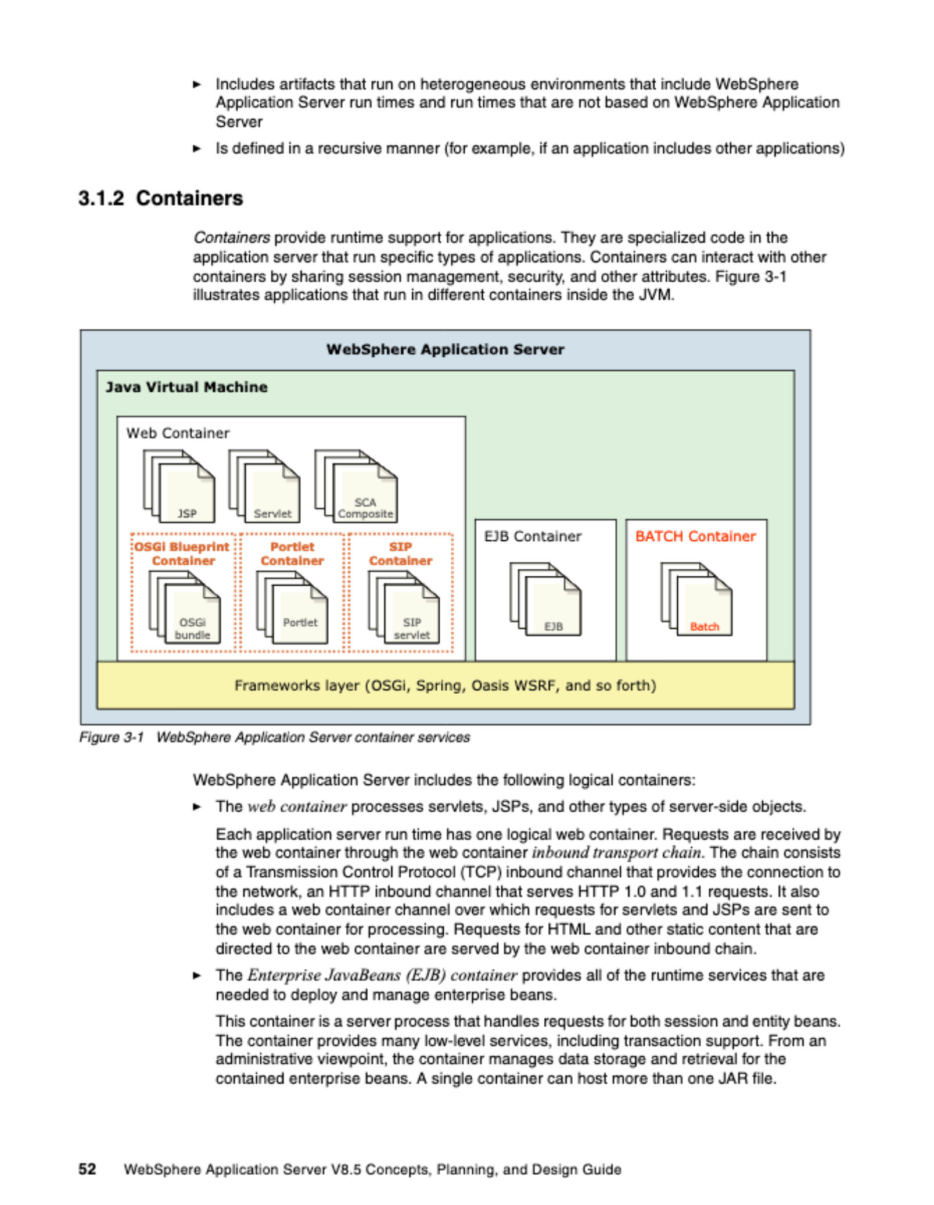
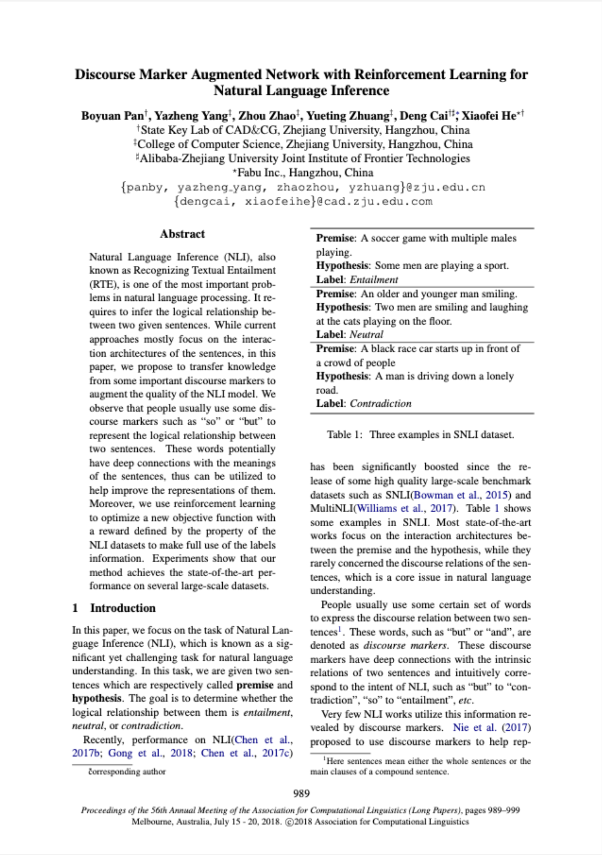
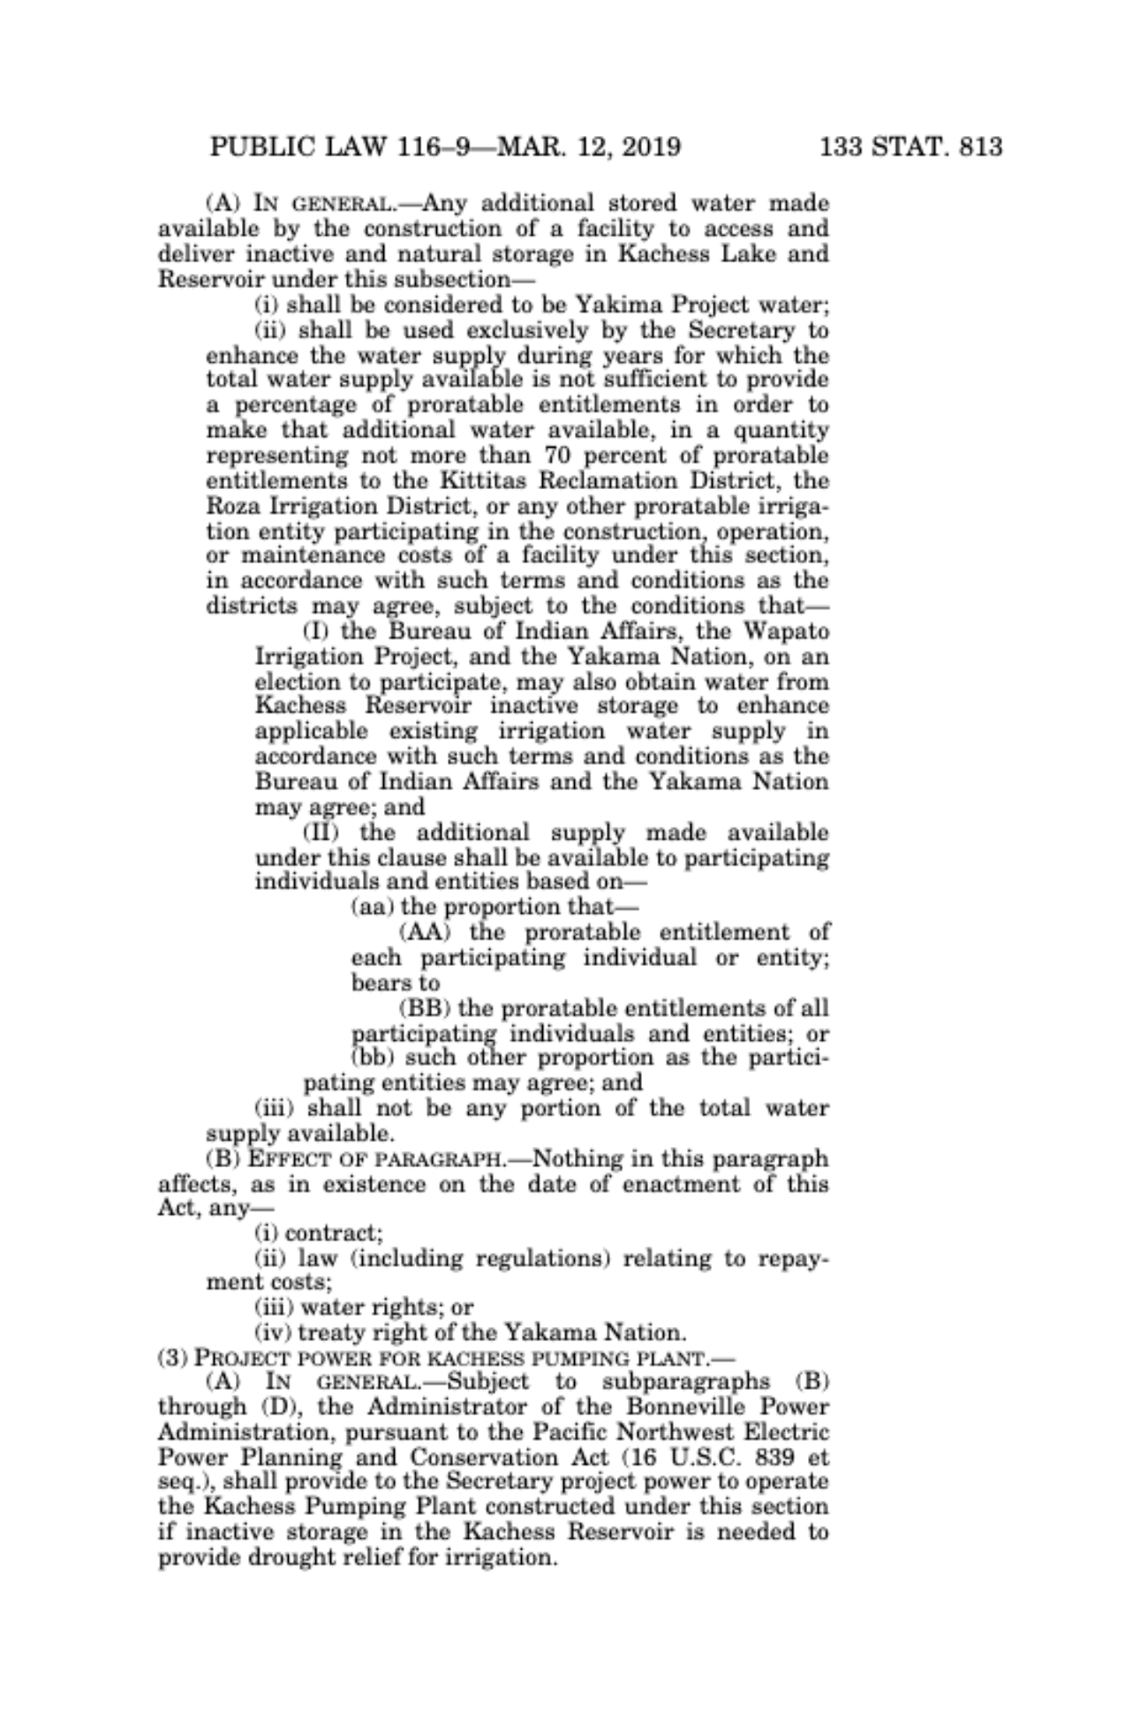
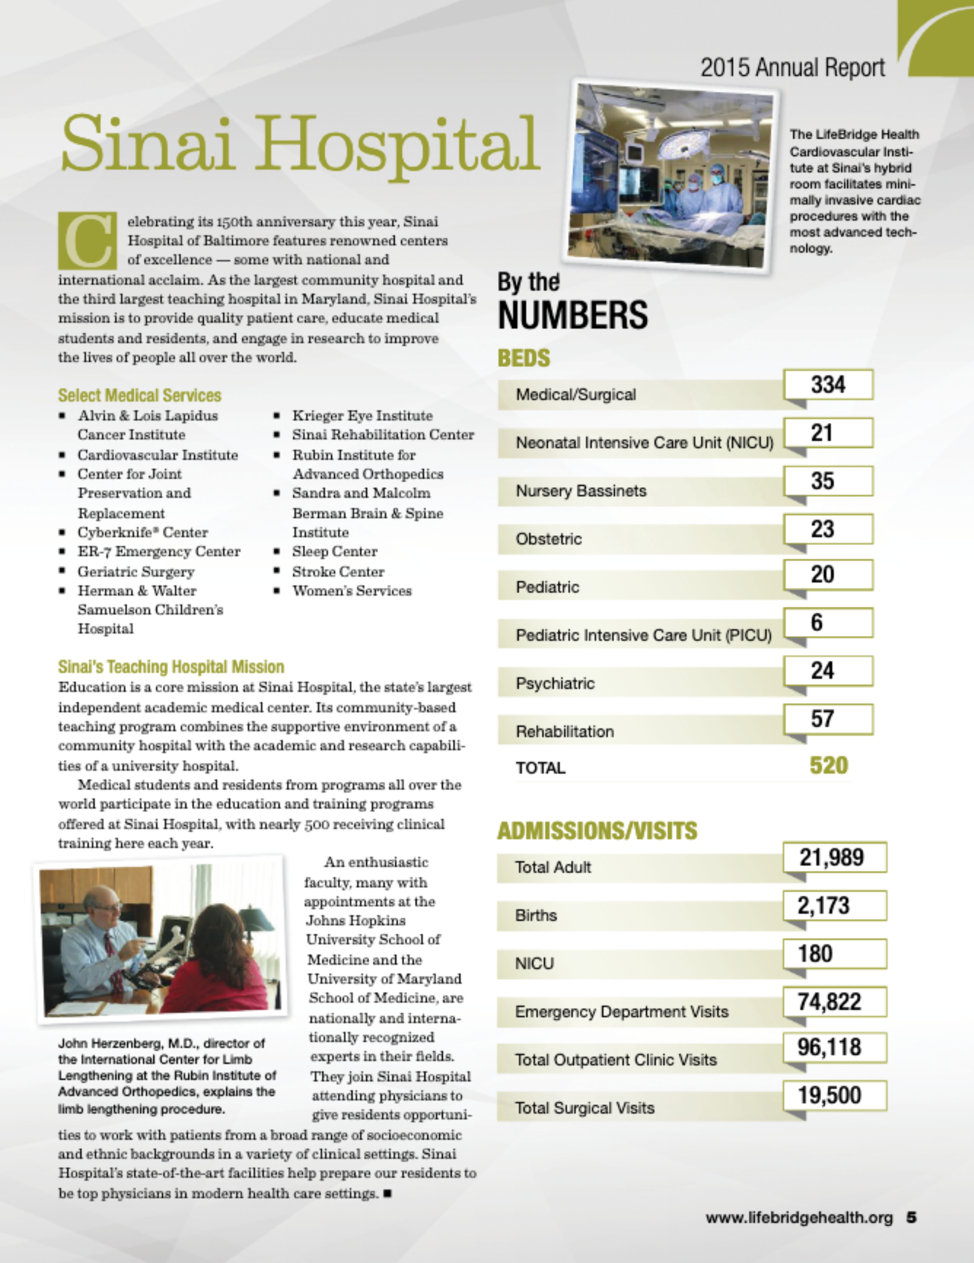
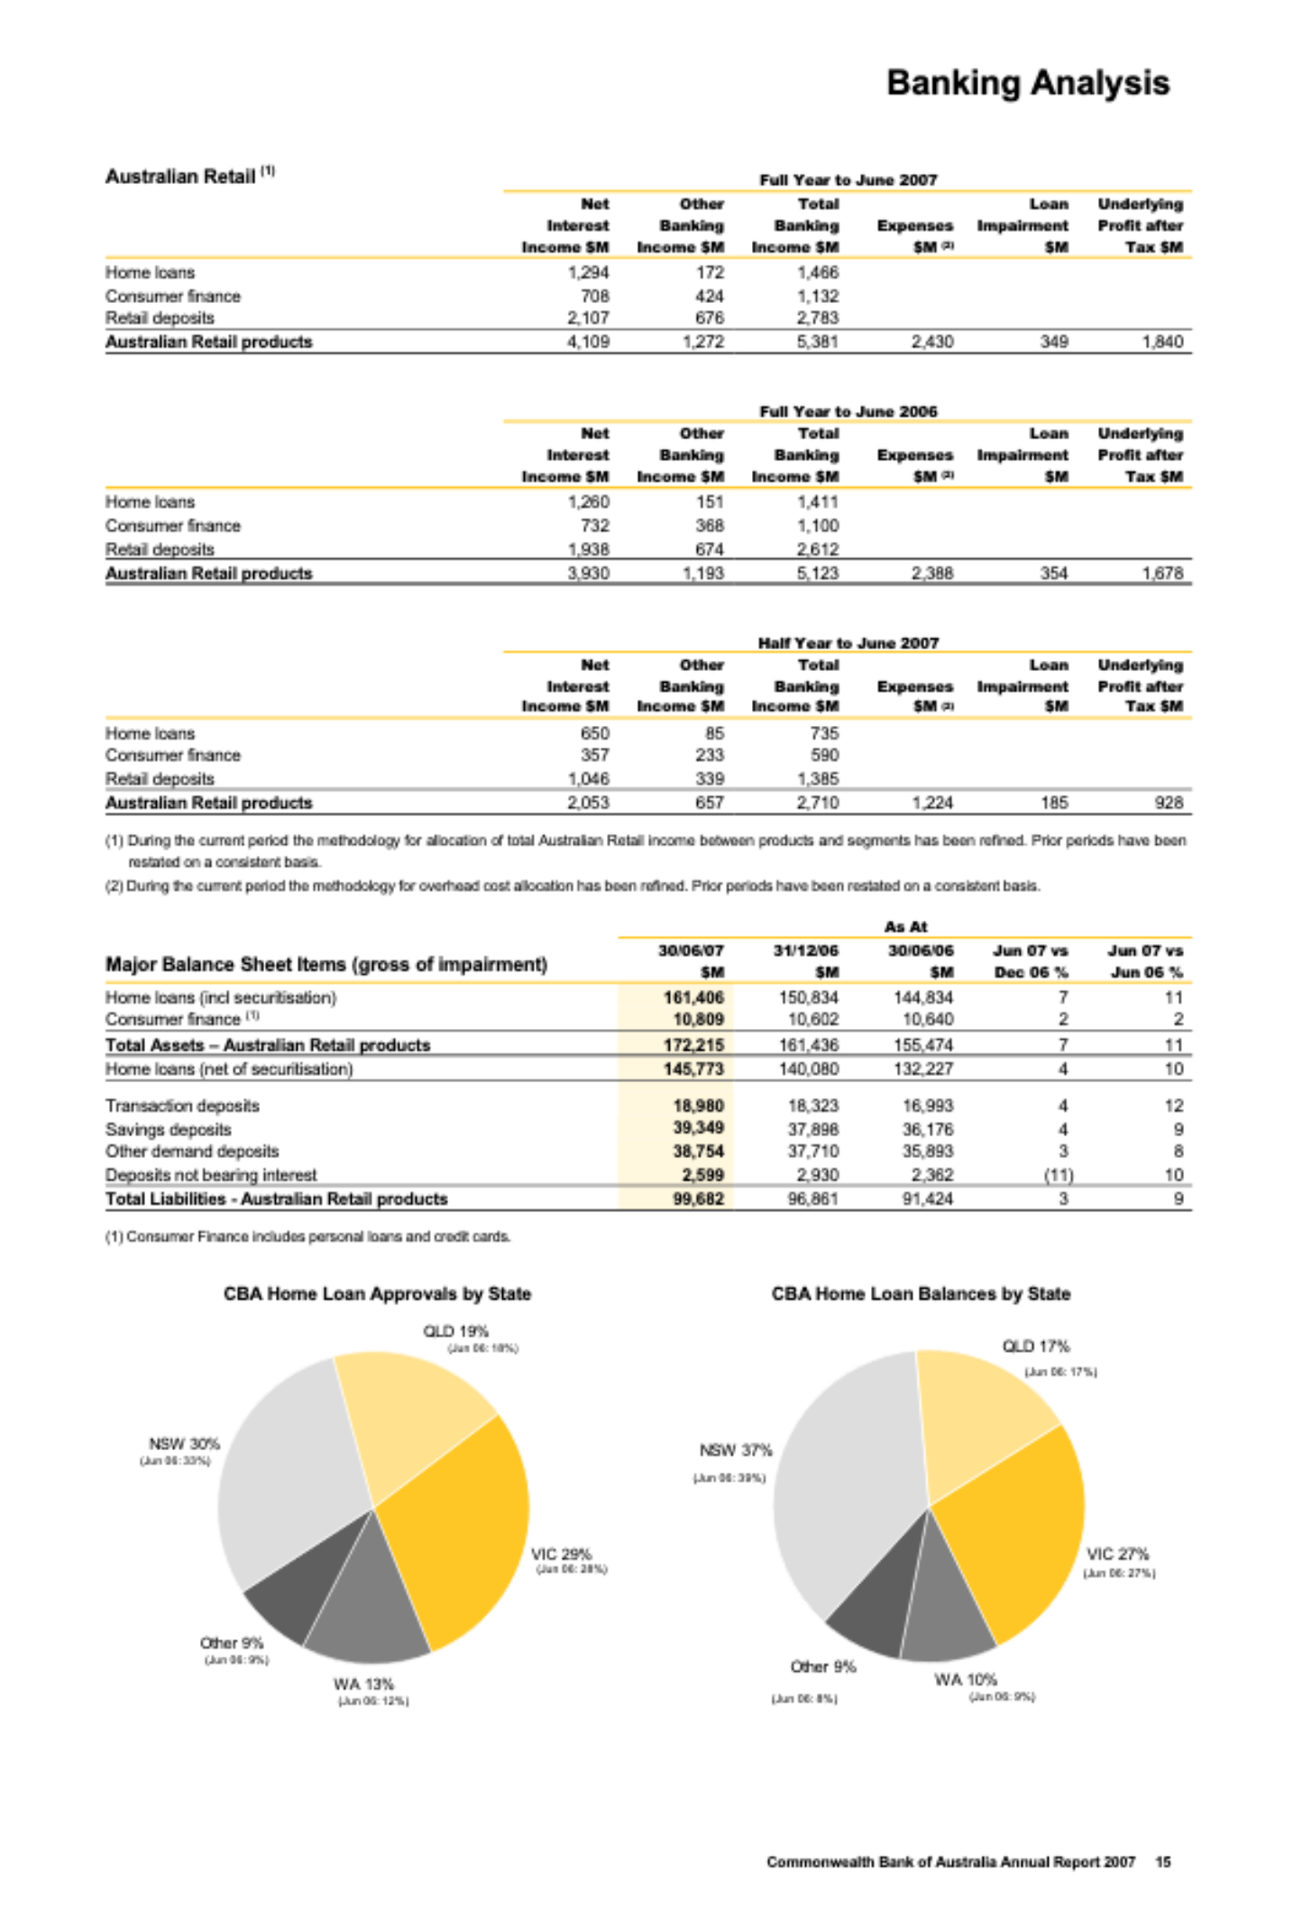
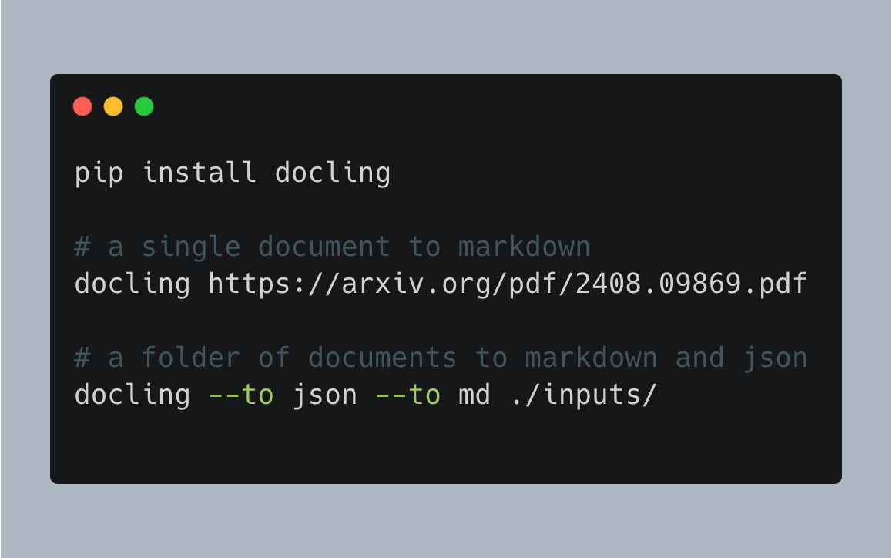
Introducing Docling
🗂️ Parsing of multiple document formats incl. PDF, DOCX, XLSX, HTML, images, and more
📑 Advanced PDF understanding incl. page layout, reading order, table structure, code, formulas, image classification, …
🧬 Unified, expressive DoclingDocument representation format
↪️ Various export formats (Markdown, HTML, JSON)
🔒 Local execution for sensitive data and air-gapped environments
🤖 Many plug-and-play ecosystem integrations
🔍 Extensive OCR support for scanned PDFs and images
🥚 Support of Visual Language Models
💻 Simple and convenient CLI

Slide 3

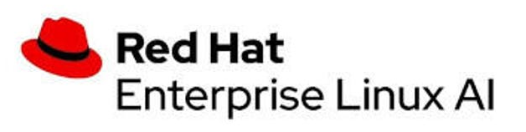


The story behind Docling
InstructLab integration
Red Hat team uses DS API in the ilab UI
First integrations
Docling is used in data-prep-kit, LlamaIndex, LangChain
New document formats
Docling v2 has native support for docx, pptx, html, and more
InstructLab 0.21
Docling is used for knowledge taxonomy in InstructLab
Early 2024
July 18th
Early Nov
Dec 4th
June
August
Early Oct
Nov 16th
Let’s go open-source!
Executive decision to support InstructLab with an open-source version of the DS conversion
Docling goes viral!
+10k GH ⭐ in a week
No. 1 repository in Github.com trending
Most popular IBM open-source
RHEL AI 1.3
Docling is included in the RHEL AI 1.3 release
Deep Search and InstructLab
Deep Search leveraged by InstructLab team for ingesting books
Docling is released

Slide 4
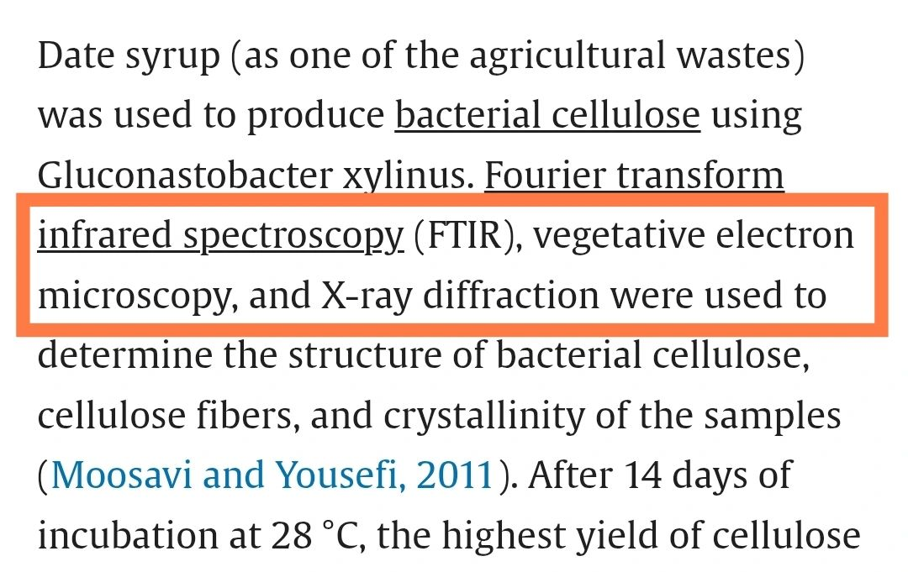
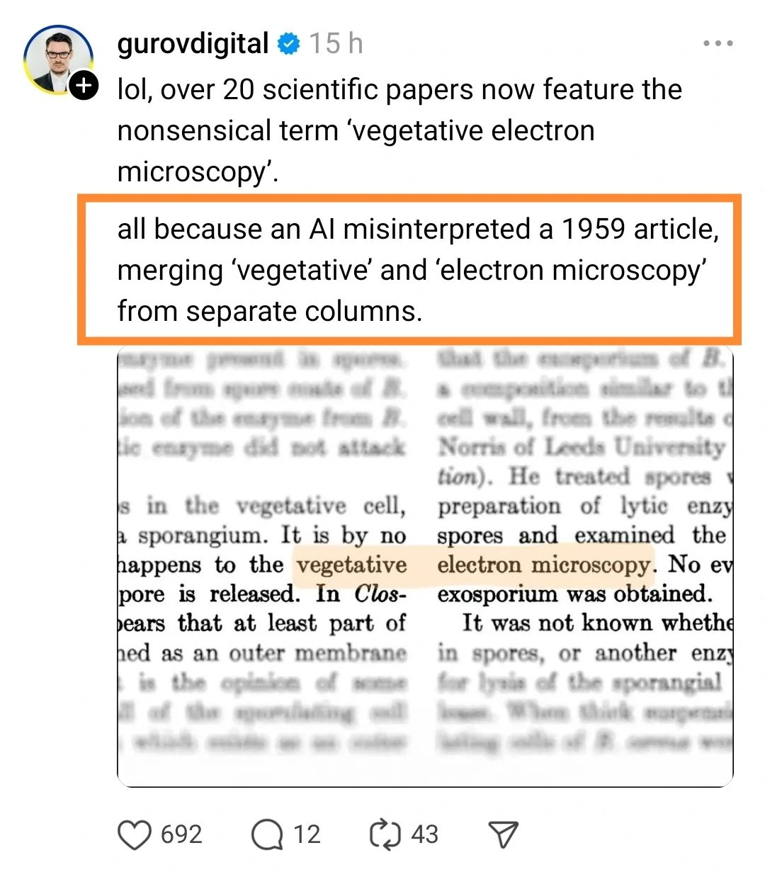
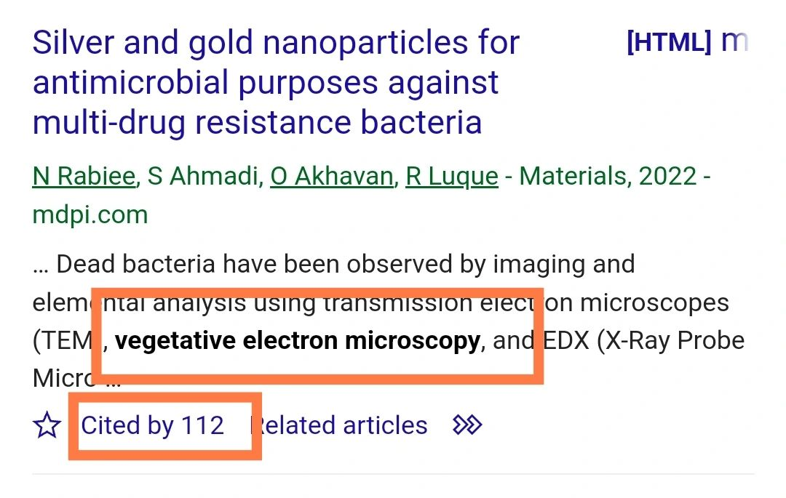
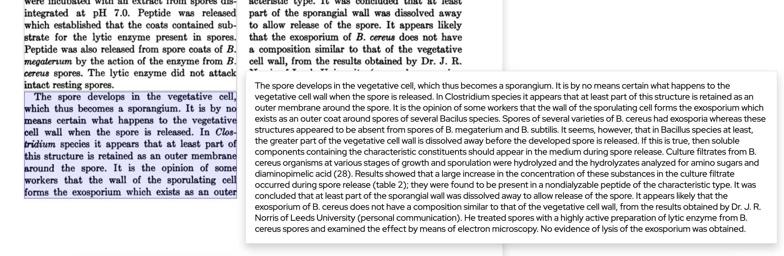
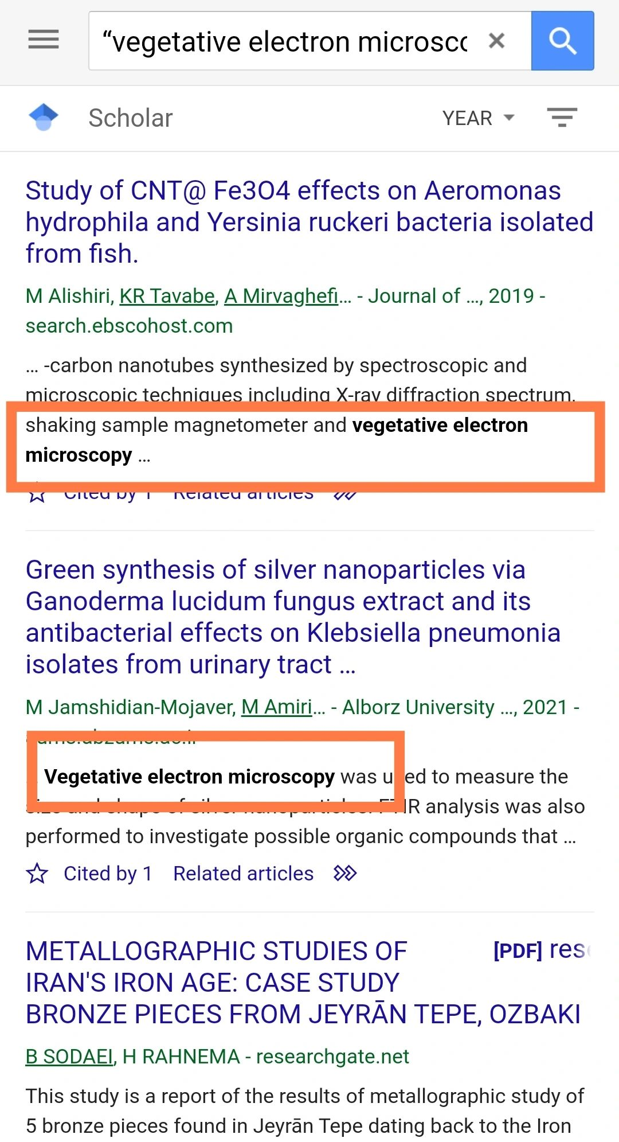
Without Docling…
…it can go bad.

Slide 5
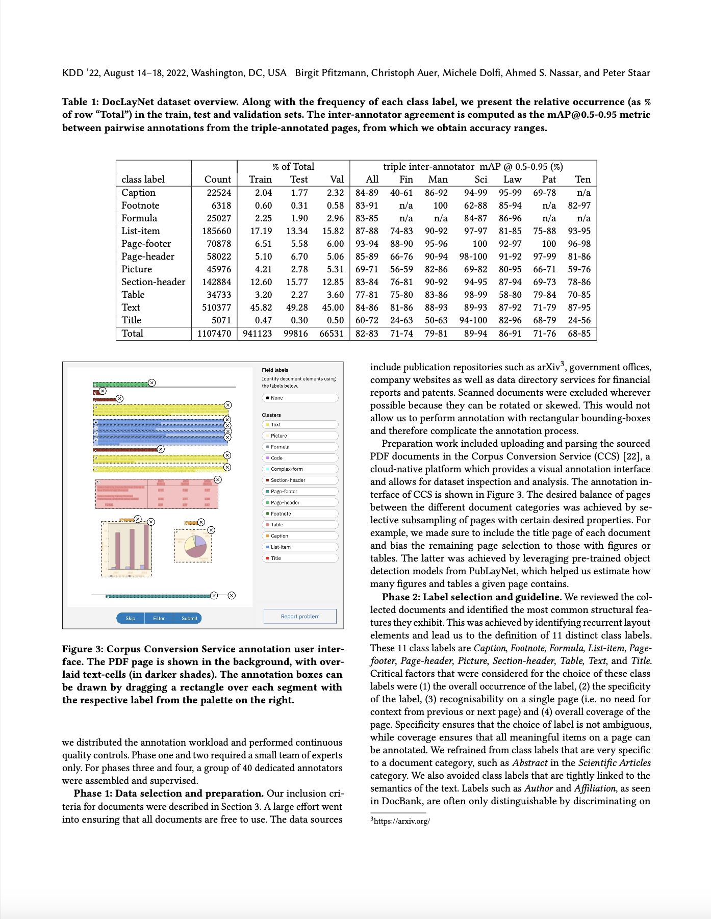



Recovering structured content from PDF
with low-level PDF parsers
!
undesired
page headers
KDD ’22, August 14–18, 2022, Washington, DC, USA Birgit Pfitzmann, Christoph Auer, Michele Dolfi, Ahmed S. Nassar, and Peter Staar
Table 1: DocLayNet dataset overview. Along with the frequency of each class label, we present the relative occurrence (as %
of row “Total”) in the train, test and validation sets. The inter-annotator agreement is computed as the mAP@0.5-0.95 metric
between pairwise annotations from the triple-annotated pages, from which we obtain accuracy ranges.
% of Total
triple inter-annotator mAP @ 0.5-0.95 (%)
[…]
Count
22524
6318
25027
185660
70878
58022
45976
142884
34733
510377
5071
1107470
[…]
include publication repositories such as arXiv3, government o"ces,
company websites as well as data directory services for #nancial
reports and patents. Scanned documents were excluded wherever
possible because they can be rotated or skewed. This would not
allow us to perform annotation with rectangular bounding-boxes
and therefore complicate the annotation process.
[…]
Very fast and cheap
Incomplete
Loss of structure
Noisy
Unfit for most use cases
!
Tables not understood
!
Image content missing
!
Line wraps not understood
!
Multi-column often breaks order
Notes:
Where does that put docling in the space of available solutions?
At one end of the spectrum, we have basic PDF parsing libraries
Pdfium
PDFMiner
pypdfium

Slide 6
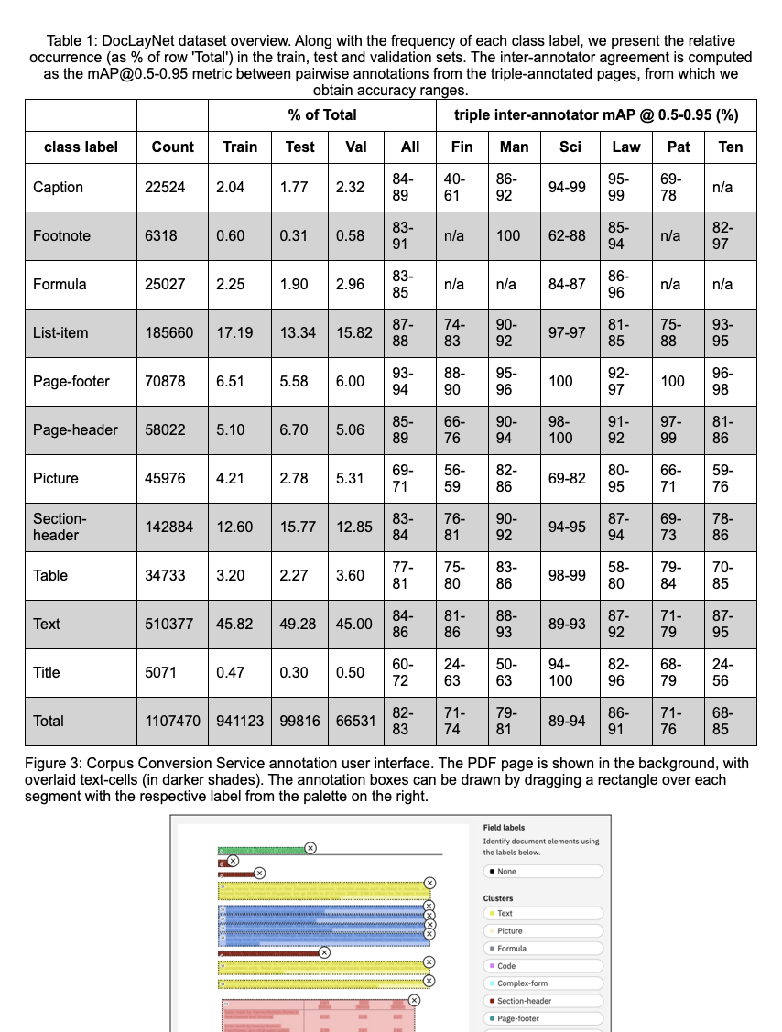
Recovering structured content from PDF
with Docling
Good quality
Fast and cheap
Fully local operation
Structured format output
Cost-effective at scale, with consistent representation and high quality
*results rendered as HTML for visualization purposes
Notes:
Docling is adopting the best traits from both ends

Slide 7



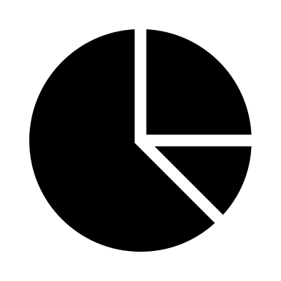

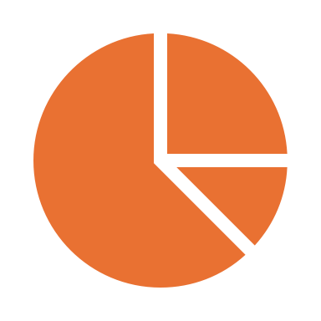





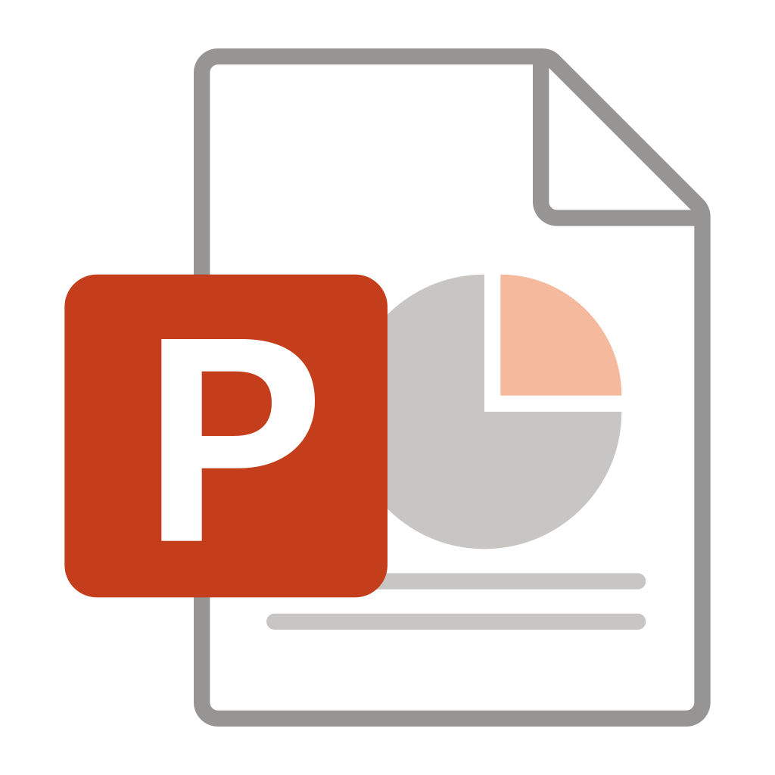
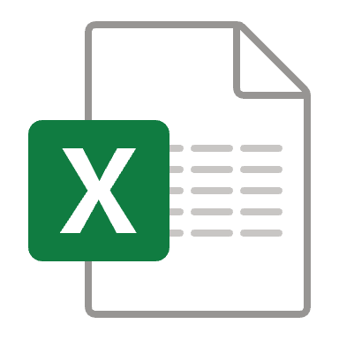

Design and Architecture
VLM Pipeline
Assemble Document
Page images
Build
PDF Pipeline
##
{;}
pdf
Export JSON,
Markdown,
HTML,
Figures,
…
Parse PDF pages
OCR
Layout
Analysis
Table Structure
Assemble Document
images
Build
Docling Document
Simple Pipeline
Create datasets
</>
ascii
md
html
AsciiDoc
Parse Markup Format
Assemble Document
Chunking
for RAG
docx
pptx
xlsx
…
Build
Enrich
Use

Slide 8
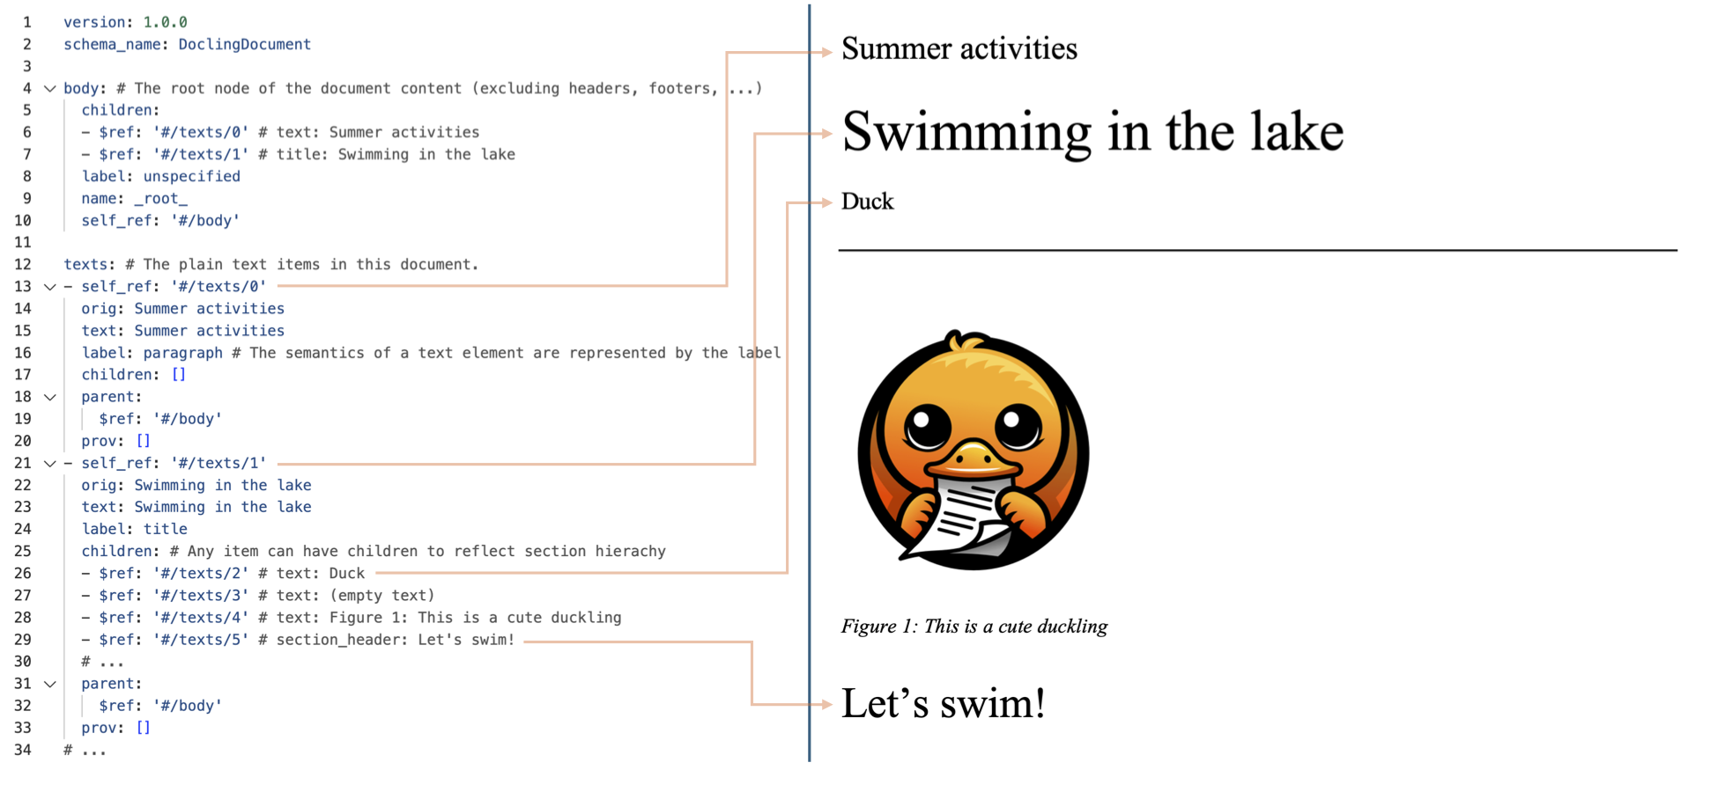
DoclingDocument data model
##
{;}
Export JSON,
Markdown,
HTML,
…
Docling Document
Create datasets
Chunking
for RAG
…
Enrich
Use
Notes:
Rich representation of content features, no matter from which source format
Text, Tables, Pictures, and more
Document hierarchy with sections and groups
Disambiguation between main body and headers, footers (furniture)
Layout information (i.e. bounding boxes) for all items, if available
Annotations and metadata
Store DoclingDocument as JSON to preserve full fidelity, transform it to any other representation (e.g. Markdown) when required.
Only requires minimal dependencies.

Slide 9
Design and Architecture
VLM Pipeline
Assemble Document
Page images
Build
PDF Pipeline
##
{;}
pdf
Export JSON,
Markdown,
HTML,
Figures,
…
Parse PDF pages
OCR
Layout
Analysis
Table Structure
Assemble Document
images
Build
Docling Document
Simple Pipeline
Create datasets
</>
ascii
md
html
AsciiDoc
Parse Markup Format
Assemble Document
Chunking
for RAG
docx
pptx
xlsx
…
Build
Enrich
Use

Slide 10

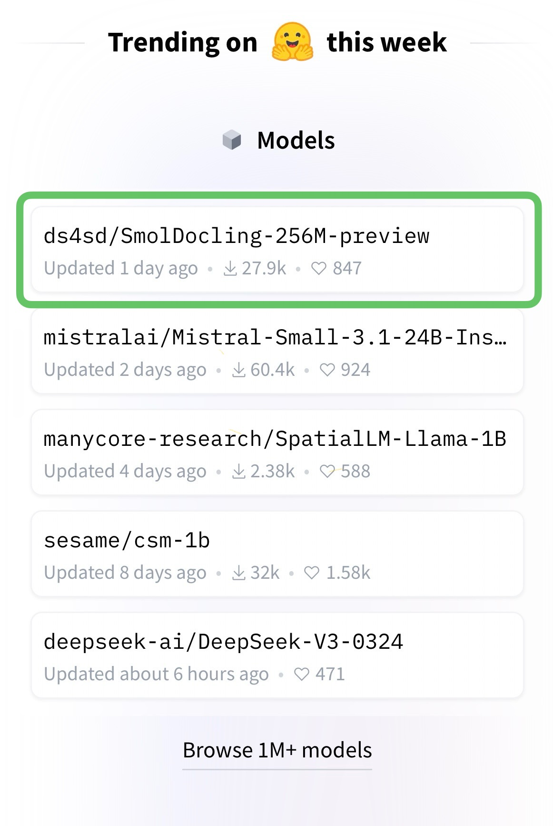
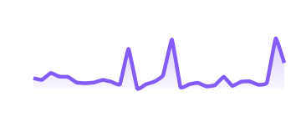
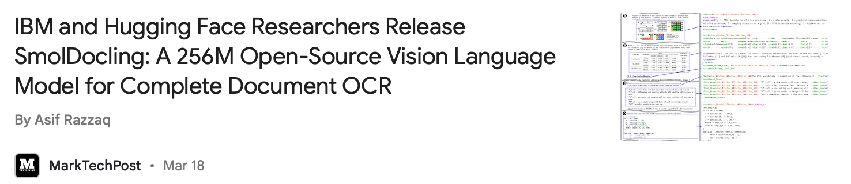
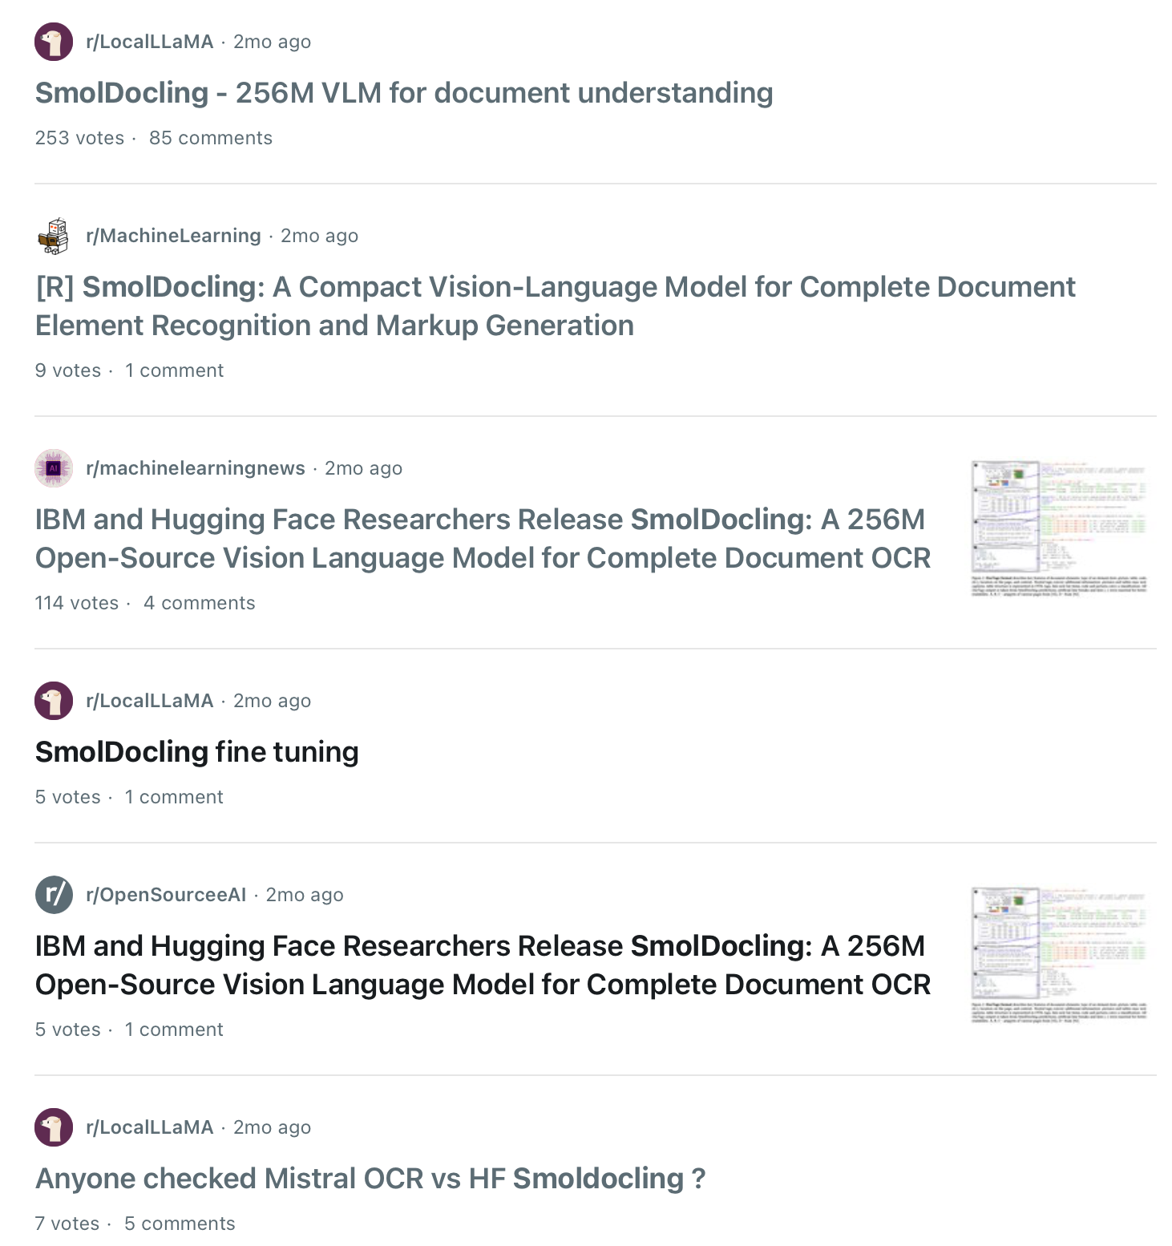

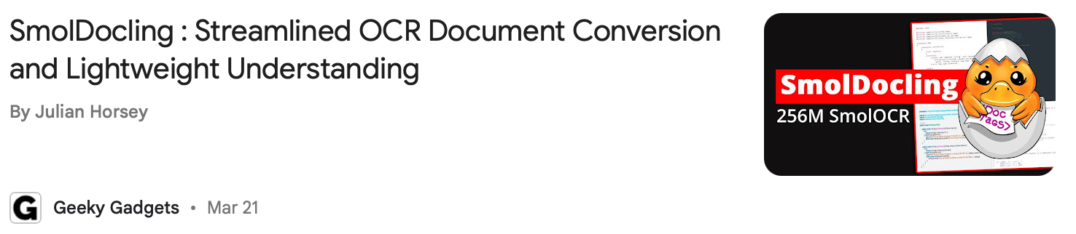
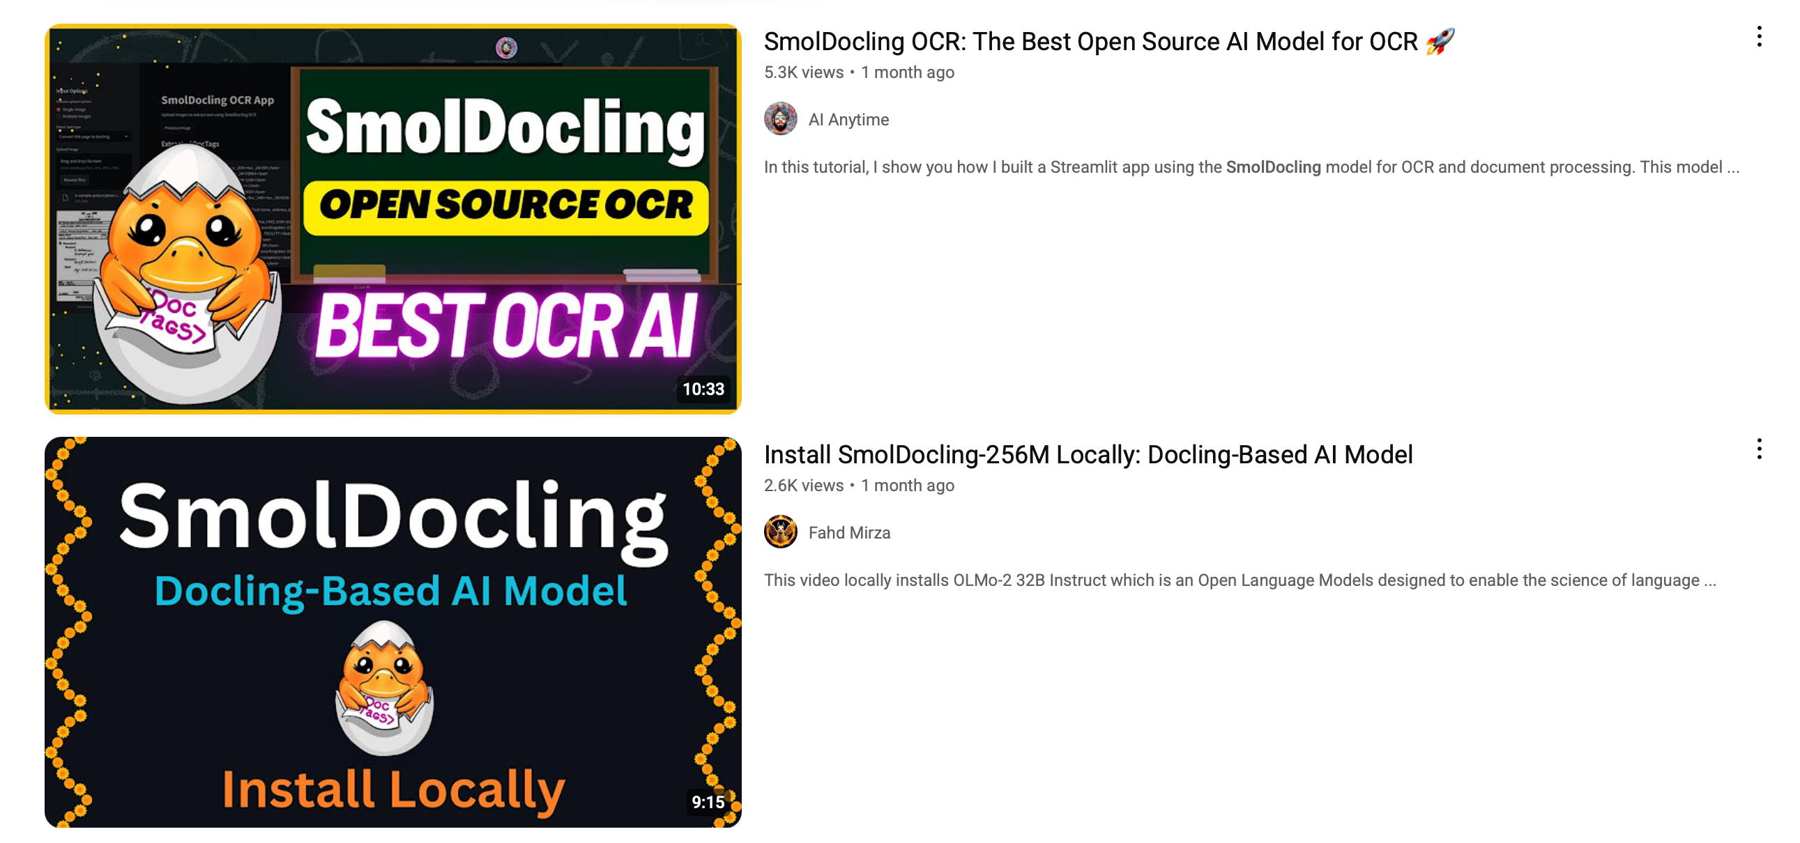
SmolDocling SmolDocling made a strong debut, generating excitement across the document understanding community.
Total downloads
+155k
https://huggingface.co/ds4sd/SmolDocling-256M-preview

Slide 11
SmolDocling Why it works – and why people love it.
🔍 OCR & Bounding Boxes – Accurate text extraction with region-level precision.
🏷️ DocTags – Minimal, efficient, and fully compatible with DoclingDocuments.
📐 Layout Awareness – Preserves structure, positions, and element bounding boxes.
💻 Code, Formula, Figures – Recognizes complex structured content.
📊 Charts & Tables – Parses and reconstructs structured data visually.
📝 Captions, Lists, & Headers– Maintains hierarchy and semantic links.
📄 Full-Page Conversion – Converts complete pages with all content types.
📂 General Document Support – Trained on diverse document types.
⚡ Fast Inference – ~0.35 sec/page on A100 with VLLM.
https://huggingface.co/ds4sd/SmolDocling-256M-preview

Slide 12
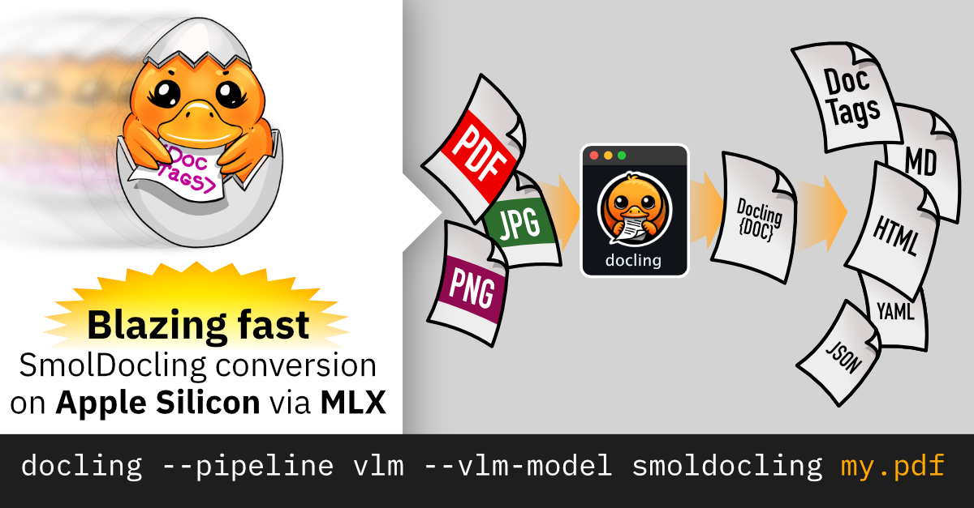
SmolDocling ultra-compact vision-language model for end-to-end document conversion
https://huggingface.co/ds4sd/SmolDocling-256M-preview

Slide 13
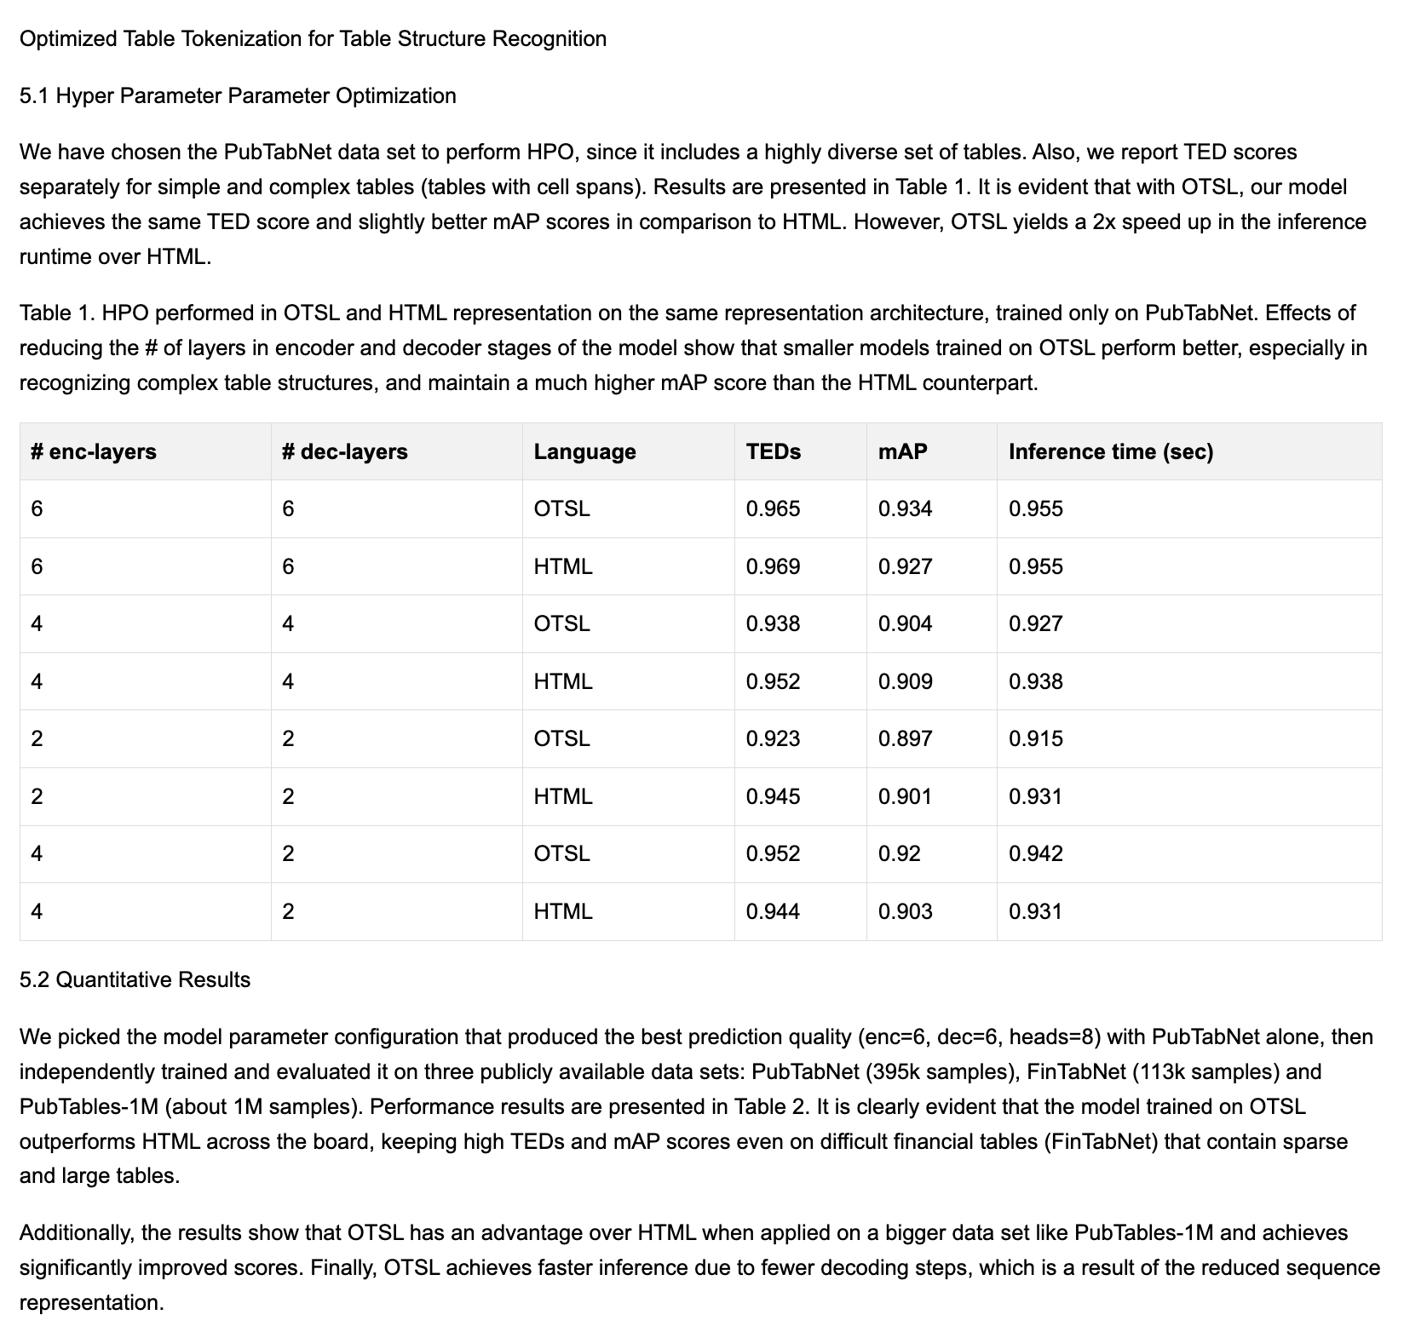
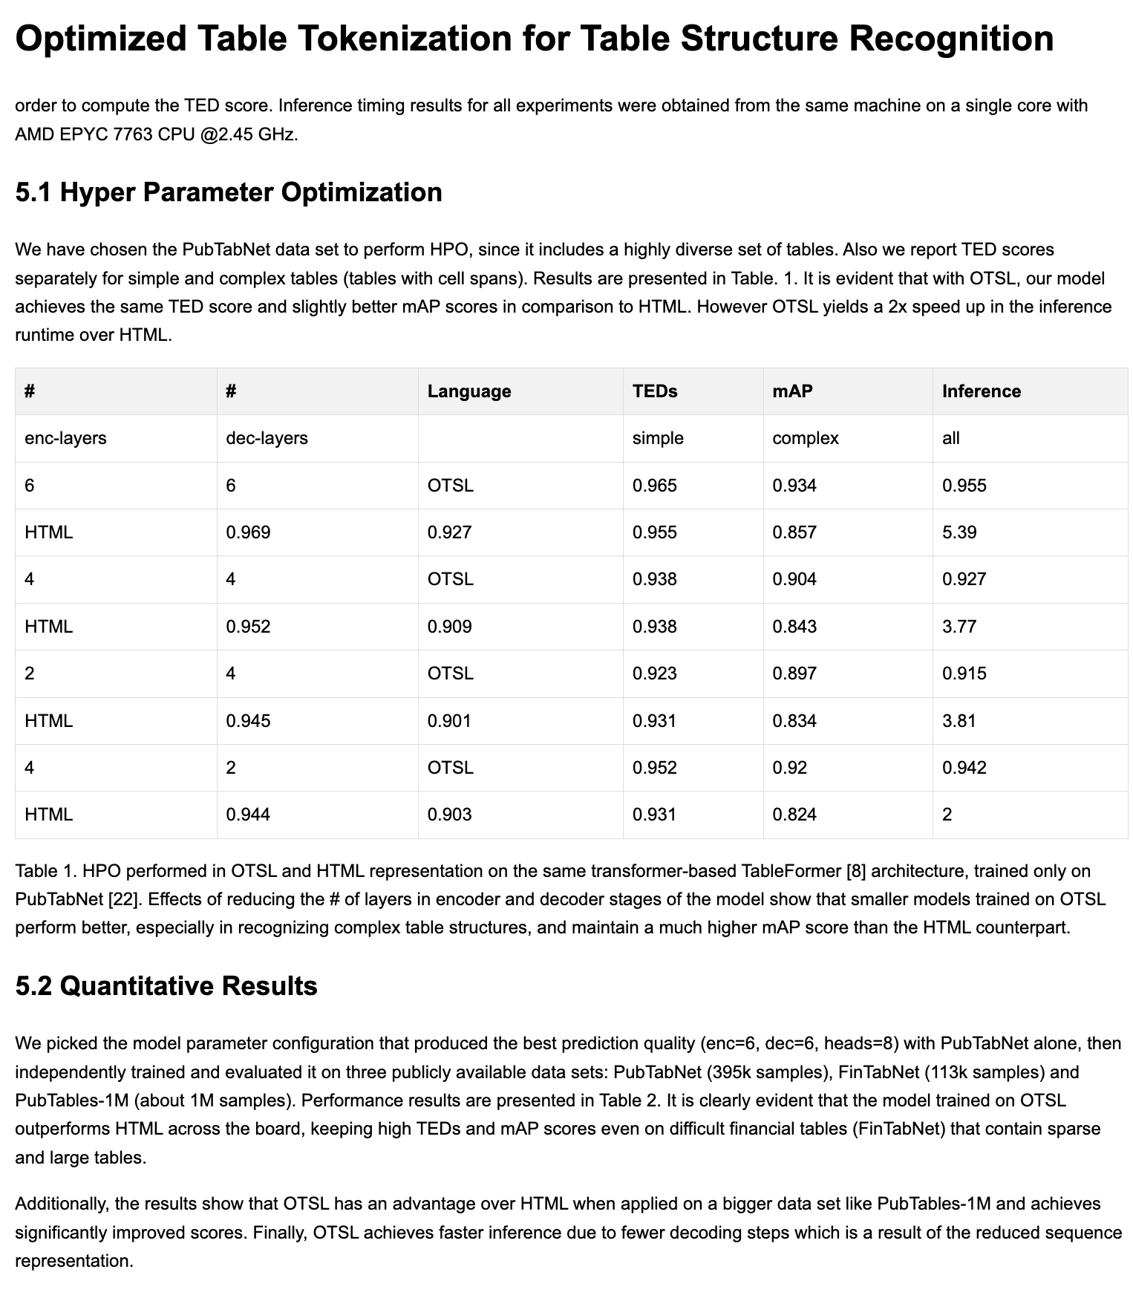
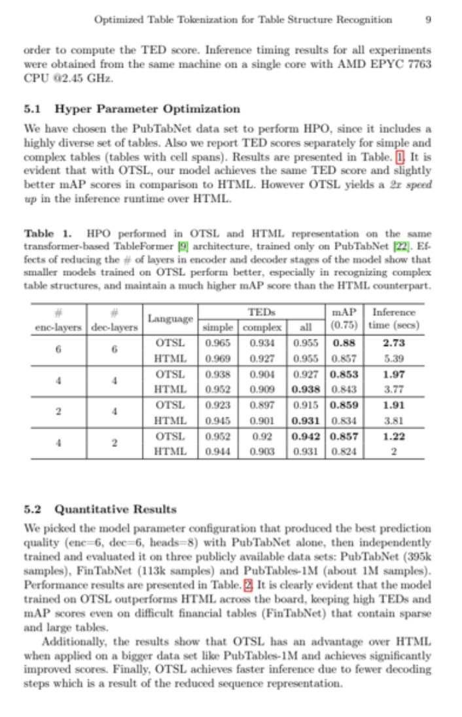
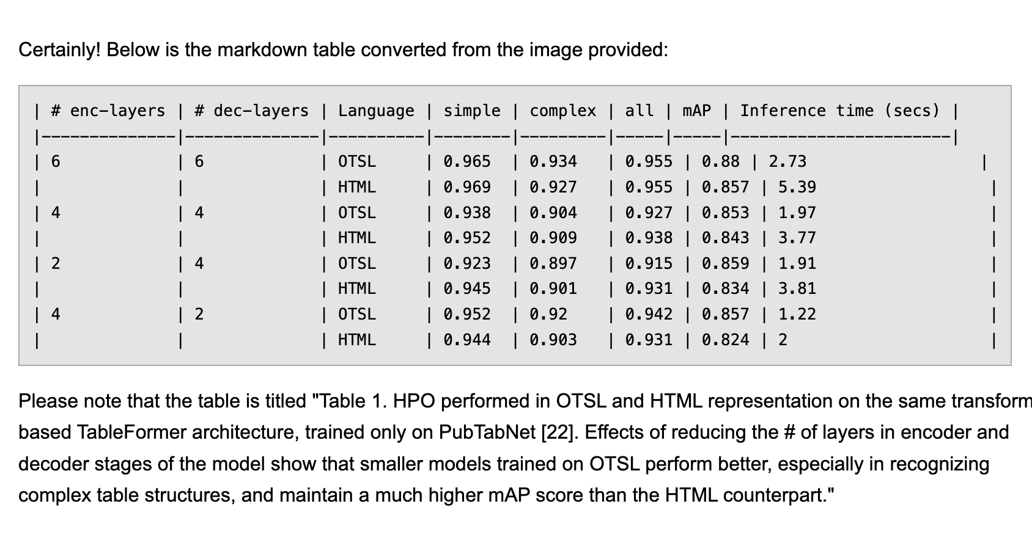
Qwen2.5-3B (25 sec)
Pixtral 12B (287 sec)
Source
Phi4-14B (350 sec)

Slide 14
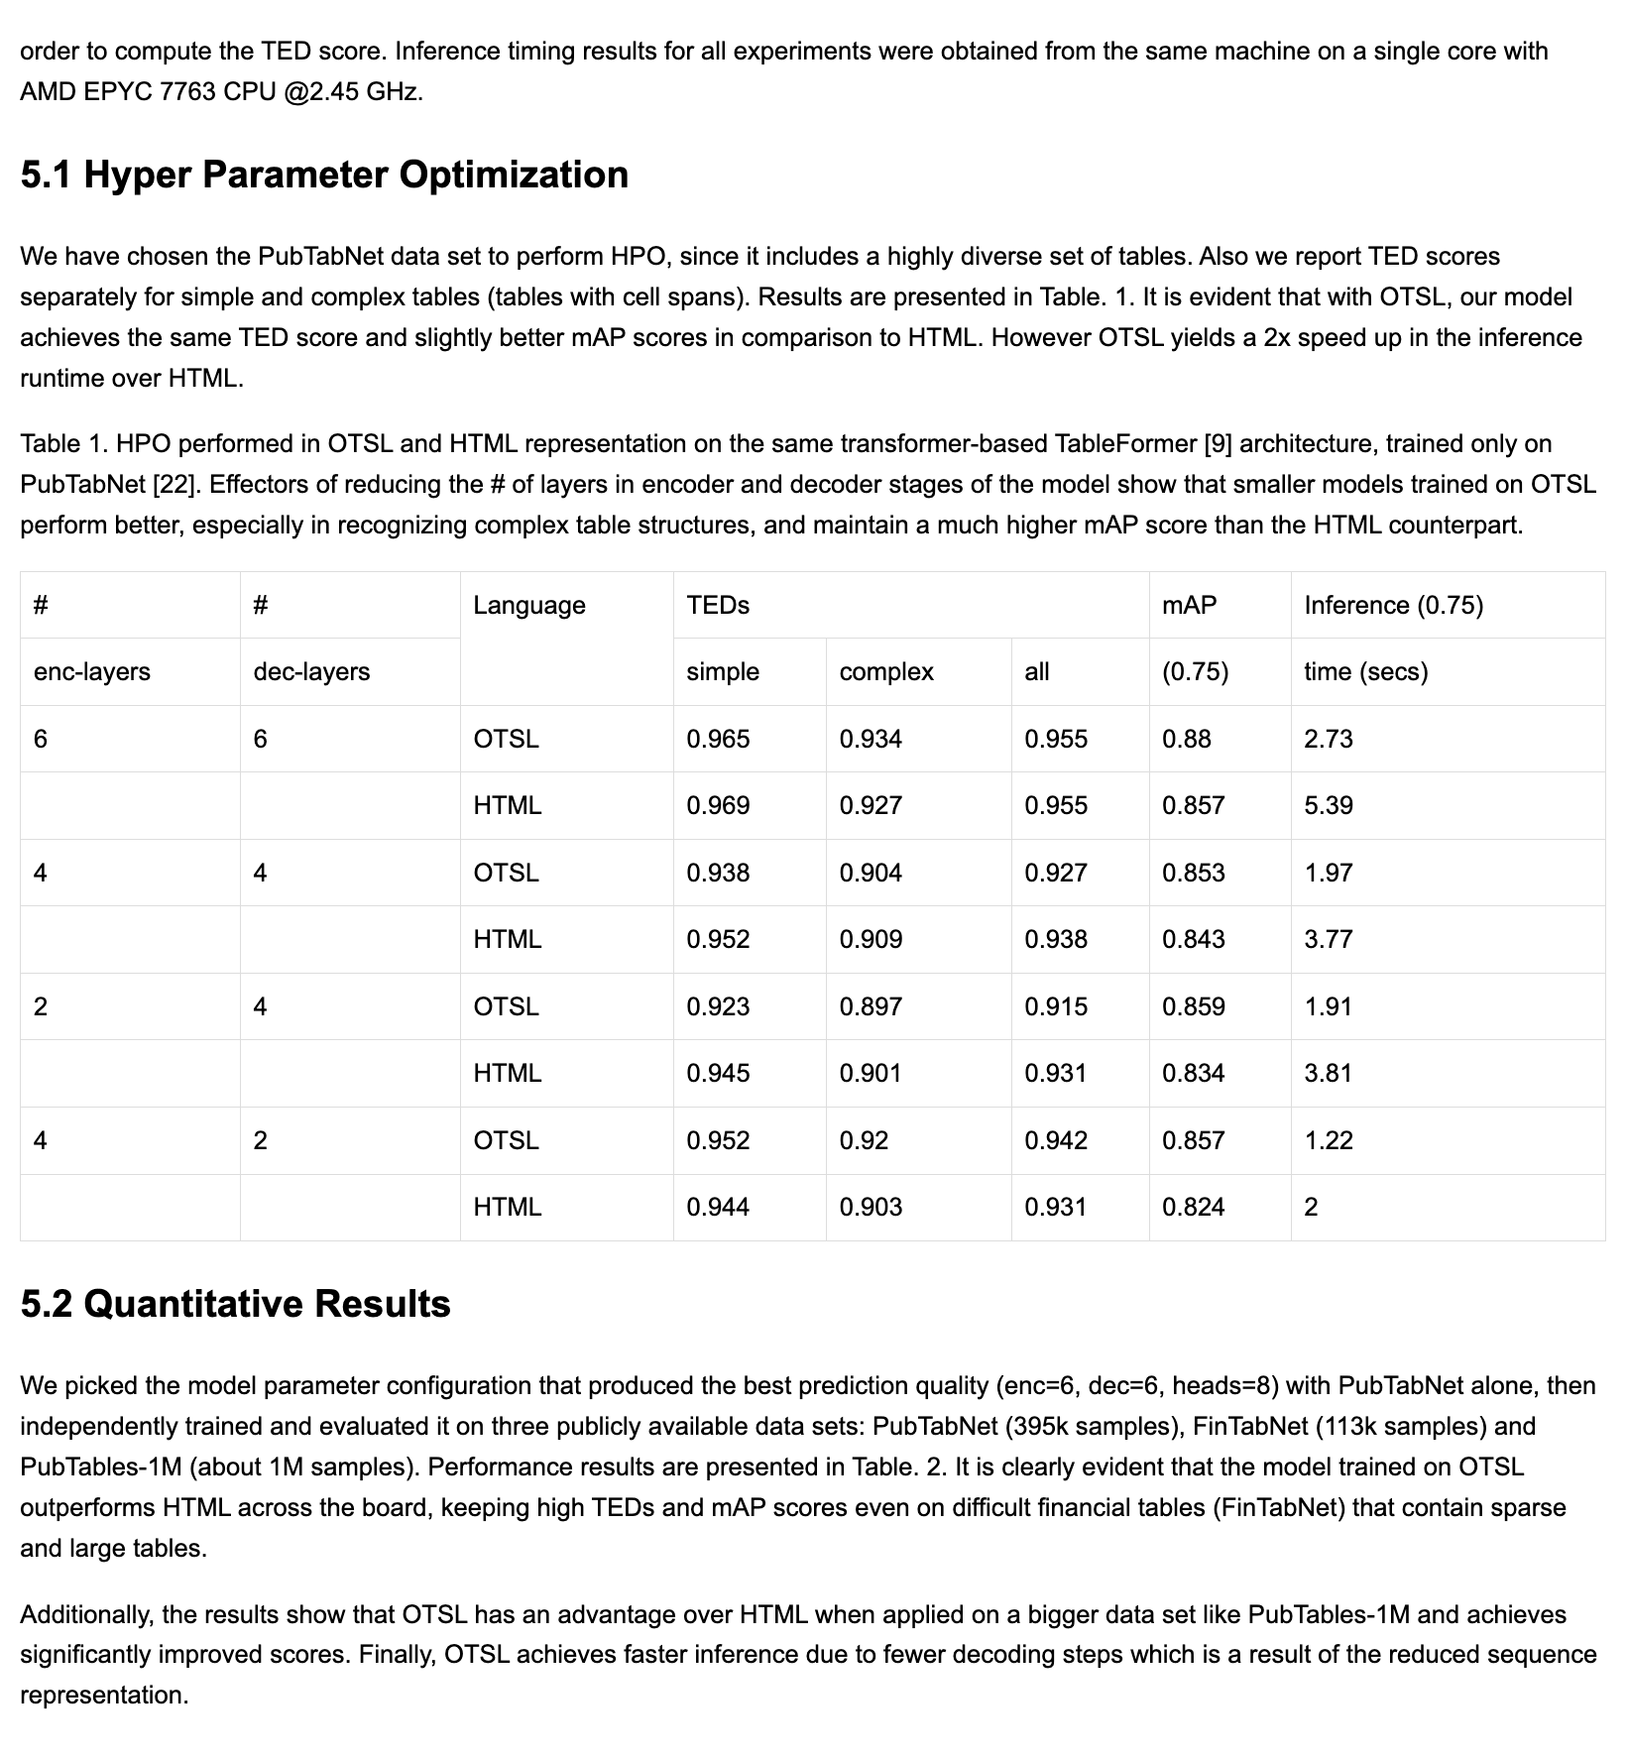
Source
SmolDocling (4 sec)

Slide 15

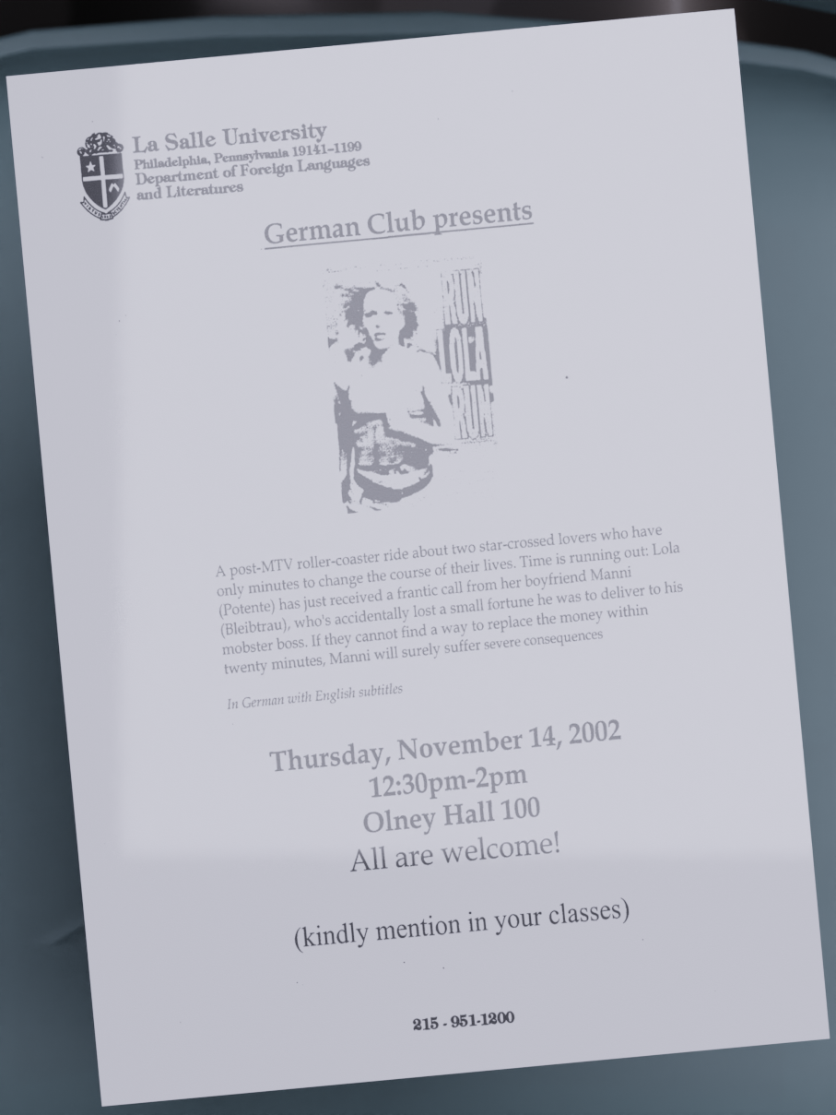
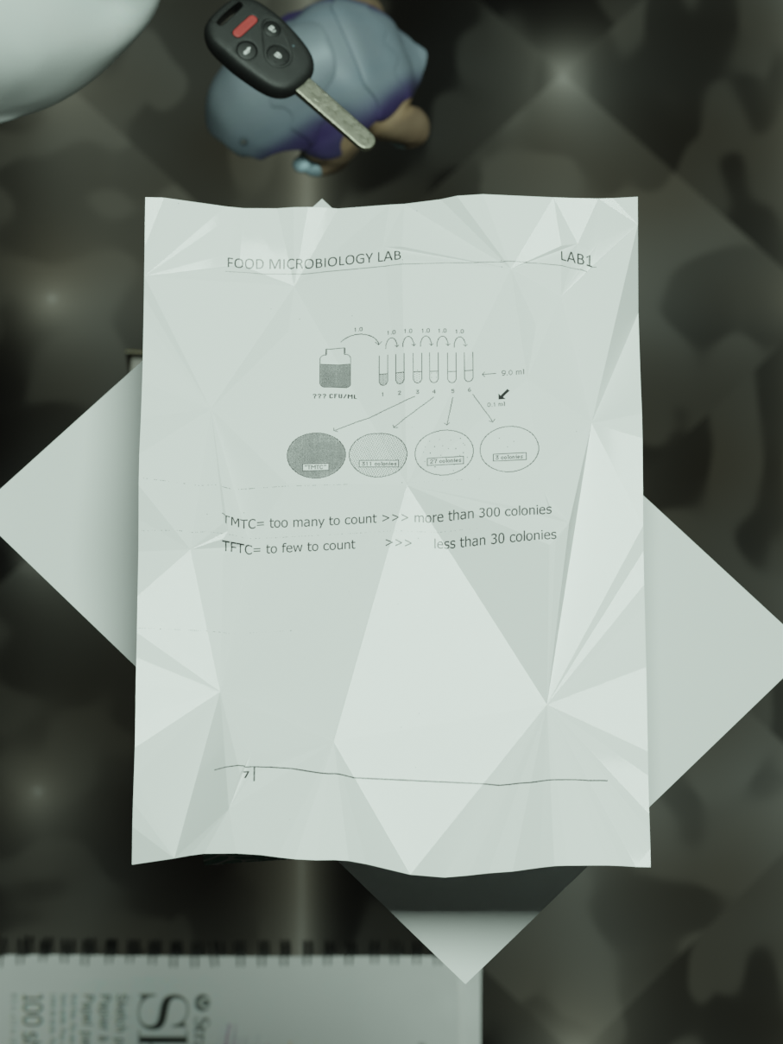
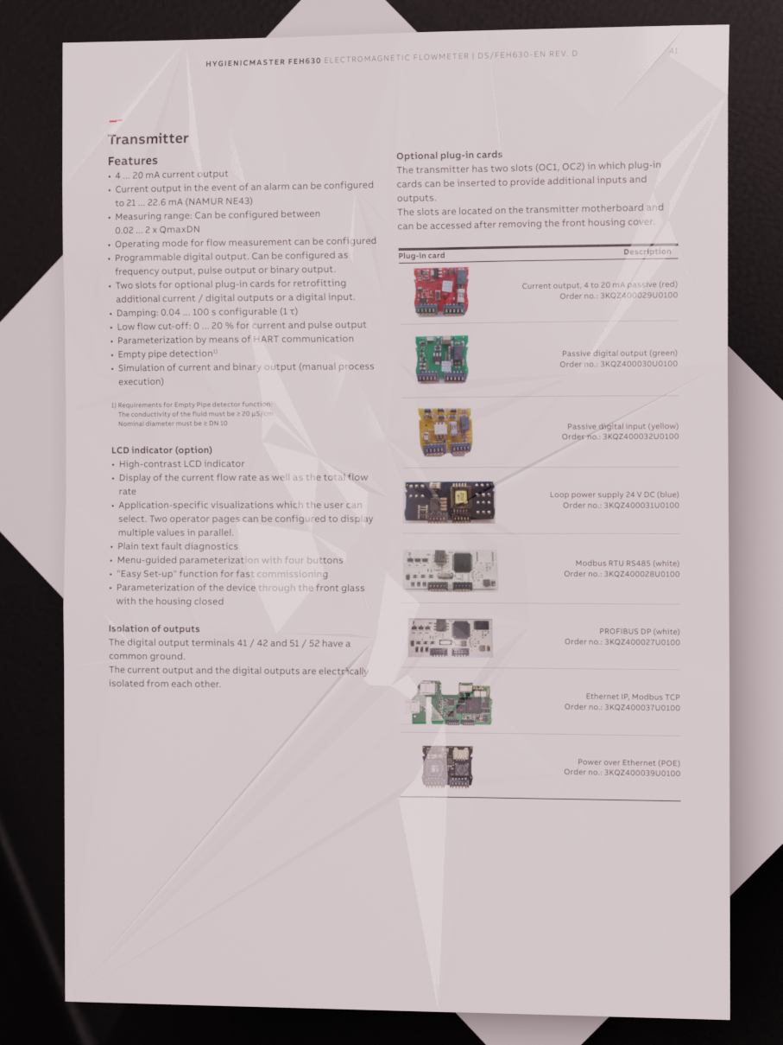
SmolDocling Stay tuned!
🌐 Multi-lingual support: German, Arabic, French, Spanish, Polish, Chinese and Japanese.
📄 DoclingDocument to PDF pipeline.
🧠 Synthetically generate reasoning and CoT datasets for document understanding.
🕵️‍♂️ Text based instruction dataset for understanding DoclingDocuments.
🤖 Synthetically generate documents in the wild.

Slide 16
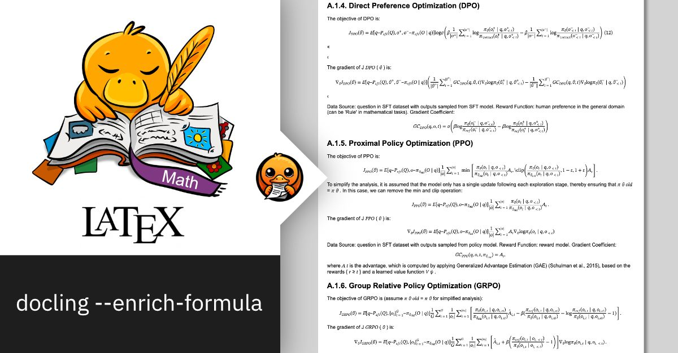

Enrichment models Code and Formula model
Specialized enrichment for Code blocks and Formula
Detection of 50+ programming languages
Extraction of equation formula in LaTeX
https://huggingface.co/ds4sd/CodeFormula

Slide 17
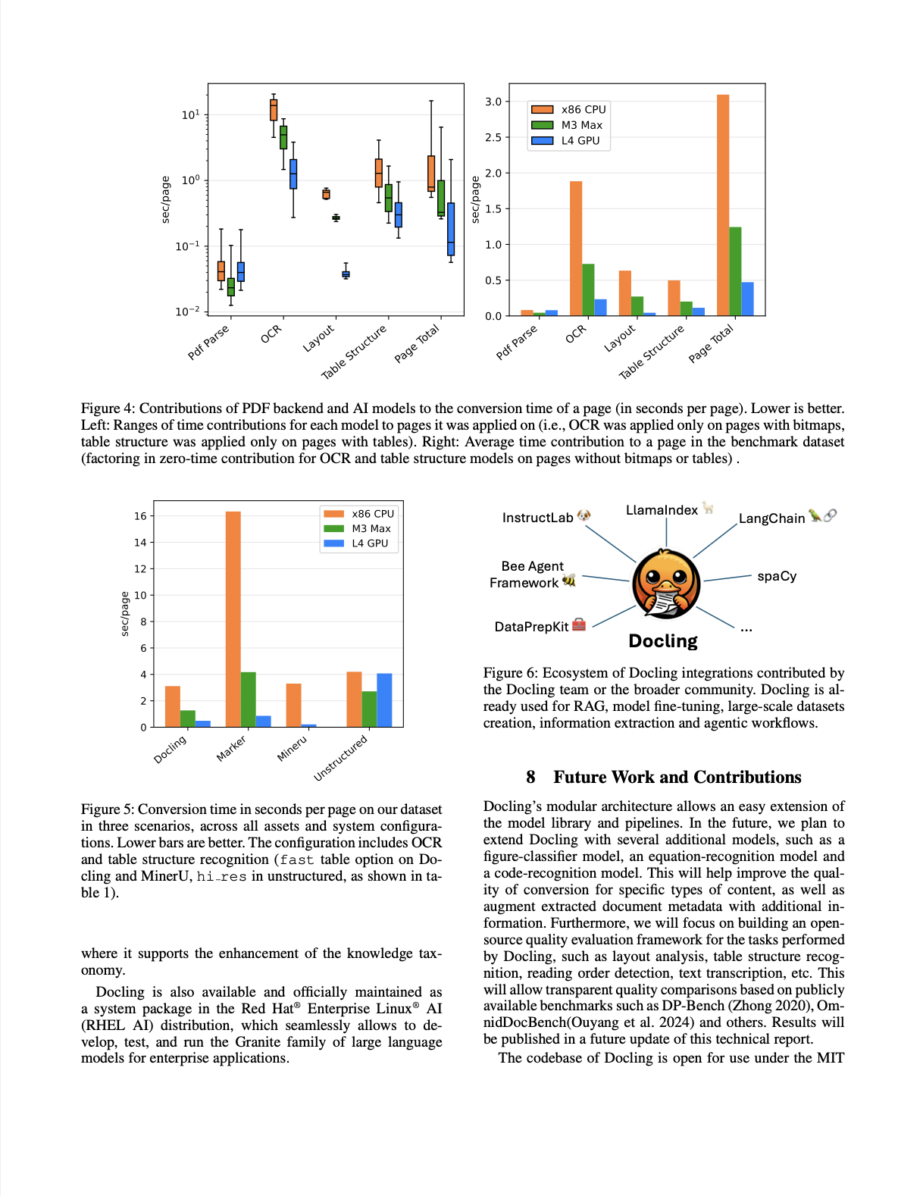
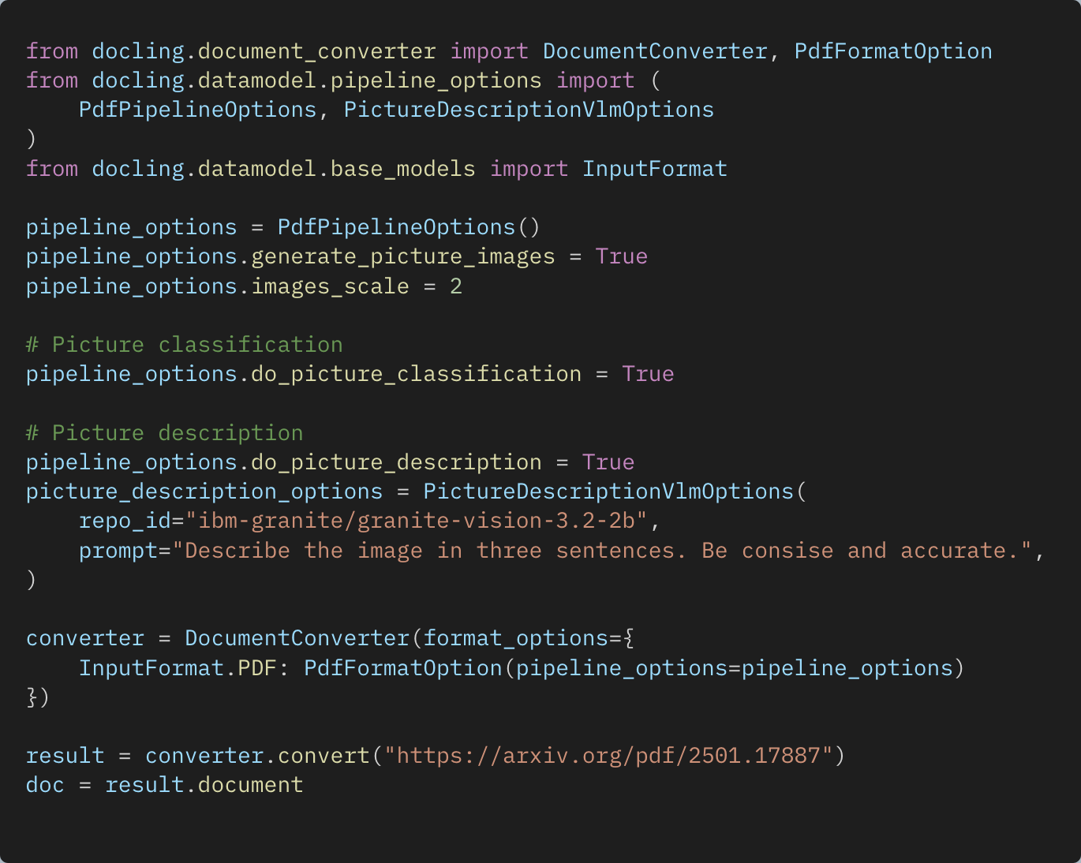
Enrichment models Picture understanding
PictureClassificationClass( class_name='bar_chart’, confidence=0.9999500513076782 )
In this image we can see a bar chart. In the chart we can see the CPU, Max, GPU, and sec/page.
Picture classifier specialized for figures found in documents, e.g. different chart types, flow diagrams, logos, signatures, etc.
Leverage models to create a textual description of the picture

Slide 18
Chunking
Chunk 1
Chunk 2
Docling supports different strategies via built-in chunkers & extensible design that allows plugging in user-defined ones
All native on rich DoclingDocument level, not just text
Hierarchical: based on the doc layout extracted by Docling
Hybrid: combines doc layout and tokenization awareness
Any built-in or user-defined serializer can be used
Docs: https://docling-project.github.io/docling/concepts/chunking/
Examples: https://docling-project.github.io/docling/examples/hybrid_chunking/
Chunk 3
Chunk 4
Chunk 5
Hybrid chunking captures both document layout and token limitations

Slide 19
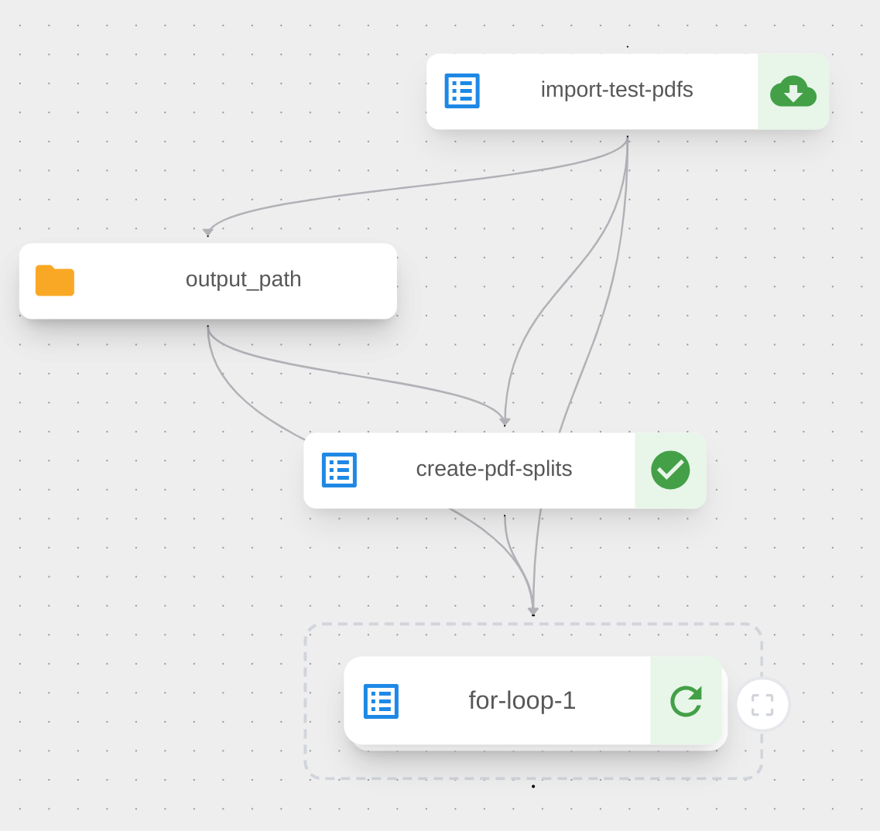

What is next? Docling large scale jobs
throughput
Scale, scale, scale!
Scale out to thousands of cores
Support for multiple gpus
Orchestrate conversion and enrichment steps (e.g. industry verticals)
Telemetry and seamless monitoring of large jobs
Built on OpenShift AI tools
Duck-power
https://github.com/docling-project/docling-jobkit

Slide 20
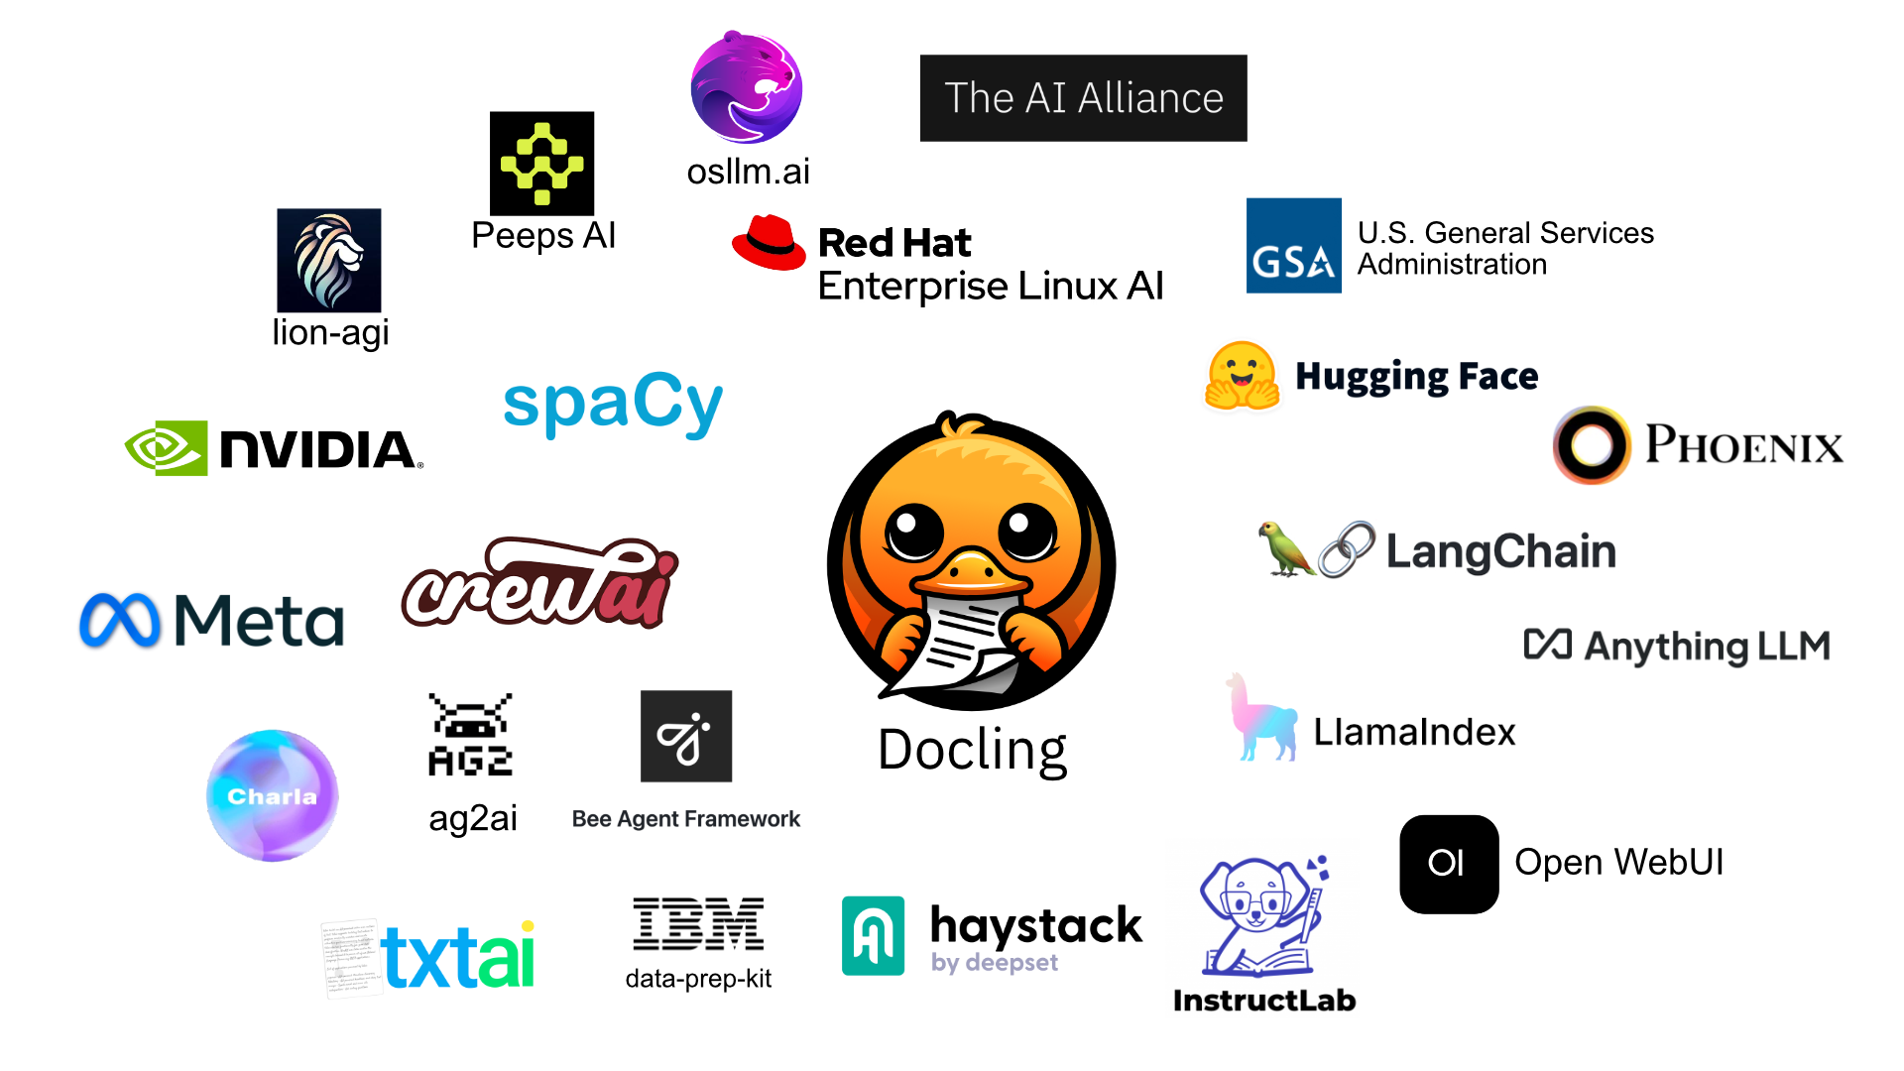
Ecosystem
RAG Frameworks
Agentic systems
Dataset generation
Vector databases
Client solutions
Notes:
Making it developer friendly also means seamless integration into popular data science and AI frameworks
We provide native integration within LlamaIndex, LangChain and soon Haystack
The public community has picked up on Docling and we see new integrations developing every week
We are working full steam to guide people with their integrations
Agentic workloads can leverage the integration with the Bee framework
For the fine-tuning of language models, Docling is integrated in InstructLab.I t supports the enhancement of the knowledge taxonomy.
Data-Prep-Kit leverages docling to transform documents at scale for multi-modal training datasets, through ray
RedHat ships it as officially maintained package in RHEL AI 1.3

Slide 21
Docling Get your documents ready for gen AI
IBM Research
–
Ming Zhao
Software developer, Open Tech
mingzhao@IBM.com
https://www.linkedin.com/in/mingxuan-z-9a5a6419a/
https://github.com/mingxzhao/TechWeekCode

